Slide 1
Local Transport Futures
Iain Docherty
Professor of Public Policy and Governance
University of Glasgow Adam Smith Business School
Iain.Docherty@glasgow.ac.uk

Slide 2
Structure of presentation
Some transport trends
Critical uncertainties
A manifesto for ‘progressive realism’
A case study
Some conclusions

Slide 3
Some transport trends

Slide 4
Peak car?
Road traffic in Scotland 2000-2010

Slide 5
More, but mostly longer rail journeys
Rail travel in Scotland 2000-2010

Slide 6
Commuting rules OK
Total trip length by purpose in Scotland 1998-2009

Slide 7
So much for the active travel agenda
Trips per head in Scotland 1998-2009

Slide 8
Policy context
There is no such thing as transport policy any more (?)
Clarity has disappeared from the debate… “New Deal… to … “Integration”… to “Choice”… to “Modal Agnosticism”… to motherhood and apple pie
Ministers are enormously nervous in revisiting the concept of sustainability in any meaningful sense
Reducing the need to travel has (almost) vanished as a policy objective
Some problems remain resilient/intractable e.g. transport/land use integration

Slide 9
A broader perspective for the future?
Transport’s place in the policy architecture
Transport per se is not the issue
Thinking in transport terms inevitably leads to focus on pet projects
The real issue is economic performance, and the ability of connectivity outcomes to support and enhance this performance
Transport policy must be part of a higher level, coherent economic and spatial strategy
The key question is:
“what are the transport outcomes (not projects) that would achieve these desired strategic (economic) policy objectives?”

Slide 10
First principles - what is transport for?
Not toys for the sake of them…
Better transport should be about achieving the outcomes we want (increased GDP growth/reduced carbon footprint/quality of life)
Transport investment needs to make a real contribution to these objectives otherwise it’s pretty pointless
Building new infrastructure doesn’t automatically grow the economy
Building new (roads) infrastructure doesn’t automatically damage the environment
Transport investment needs to be focused on those locations where transport can actually make a difference

Slide 11
Critical uncertainties

Slide 12
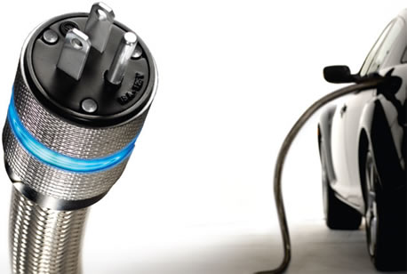
Critical uncertainty No 1… technology
Eddington said some useful things

Slide 13
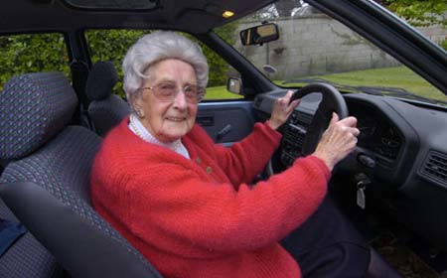
Critical uncertainty No 2… demographics
Eddington said some useful things

Slide 14
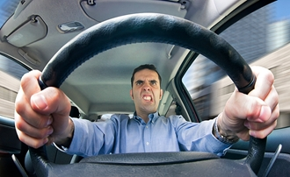
Critical uncertainty No 3… social norms

Slide 15
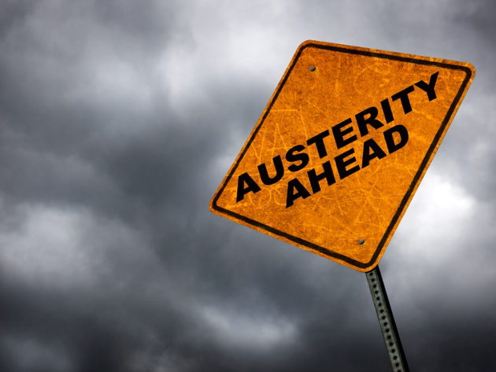
Critical uncertainty No 4… money

Slide 16
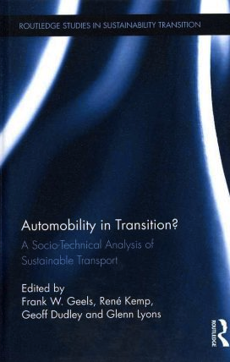
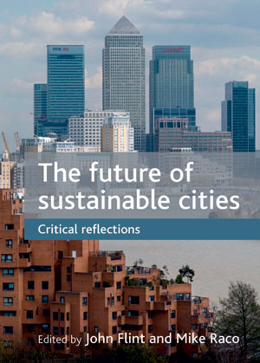

Slide 17
So, which future?
Return to ‘business as usual’?
Road traffic eventually rebounds
EVs make a real impact
With the environmental problem ‘gone’, will the car triumph?
Or something genuinely different?
Peak car is real
We stop travelling further to do the same things
Technology and the economic context change social attitudes significantly

Slide 18
A manifesto for ‘progressive realism’

Slide 19
What is transport for?
Transport is (mainly) a derived demand
So, transport per se is not the issue
Thinking in transport (infrastructure) terms inevitably leads to focusing on pet projects
The real issues are economic performance, quality of life, sustainability (etc)
So, the key question is:
“What do we want transport investment to do?”
Notes:
----- Meeting Notes (10/10/2011 10:52) -----
People don't usually travel for the sake of travelling - they do so to get to work, to education, to socialise

Slide 20
This is what we want it to do…
“Transport creates the
utilities of place”
White and Senior (1983)

Slide 21
… or, in other words, we need to ask…
What kinds of places do we want to live in?

Slide 22
Attractiveness of the car
“It seems futile to deny these things (the advantages of motorcars).The motor vehicle is a remarkable invention, so desirable that it has wound itself inextricably into a large part of our affairs. There cannot be any going back on it.”
Buchanan, Traffic in Towns (1963)

Slide 23
Problems of the car
“It is our contention that the urban crises which manifest themselves in so many ways have at least one common root. This is the increasing reliance on the automobile.
Schaeffer and Sclar (1975), Access for all: Transport and Urban Growth

Slide 24
… or
“Cities have the capability of providing something for everybody, only because, and only when, they are created by everybody.”
Jane Jacobs (1968), The Death and Life of Great American Cities

Slide 25
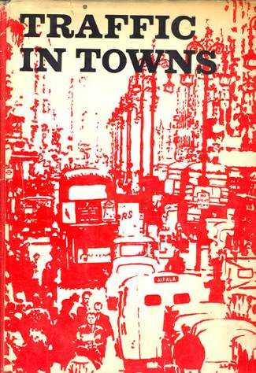
We’ve known about the choices for a long time

Slide 26
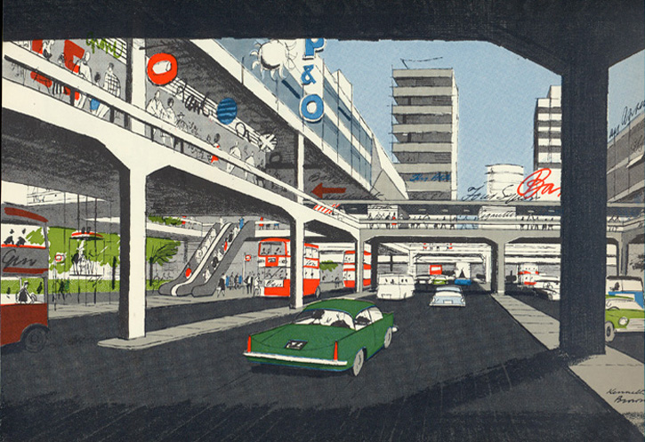
Notes:
----- Meeting Notes (10/10/2011 11:05) -----
Not Edinburgh, but it could have been...

Slide 27
Still thinking about it
The connectedness of transport affects way-finding and legibility
Transport affects the way people perceive and experience space.
People normally view cities along transport corridors, so the quality of the space in and surrounding transport is crucial to people’s enjoyment of cities
SPACE
When traffic speeds are higher, there are more injuries and fatalities
Conceptual dimension e.g. views, time, history, communities, legibility, security, safety, planning
Physical dimension e.g. transport, buildings, civic space, green space
When many pedestrians are present, there is more passive surveillance so security is normally better
Transport affects where buildings, civic space and green space are located and how people travel between them.

Slide 28
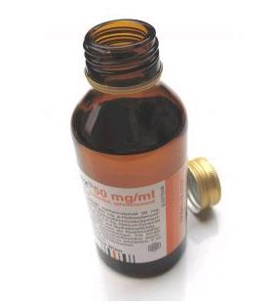
A transport reality check

Slide 29
Boys’ toys
Notes:
Transport projects are just boys’ toys

Slide 30
What should we be doing?
Notes:
The quality of our streetscape tells us everything we need to know about our collective attitudes to transport and cities

Slide 31
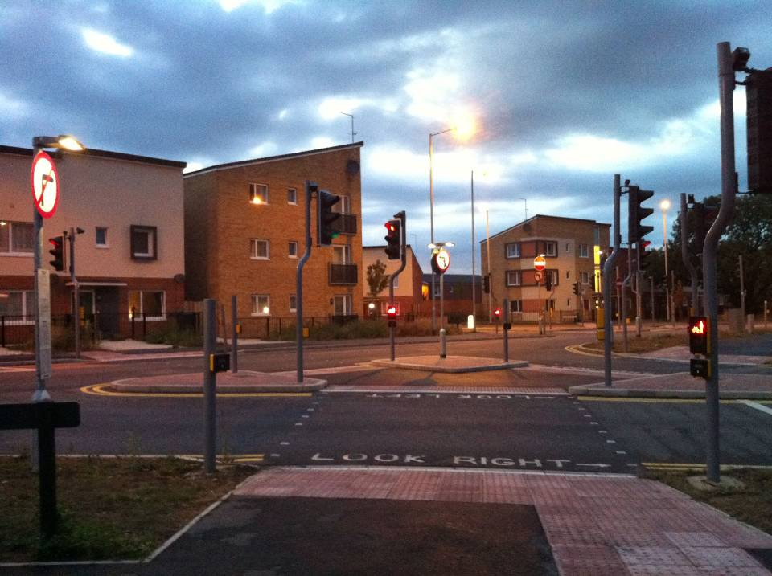
Notes:
Peterborough… what is this all about? Is this supposed to be safe? Attractive?

Slide 32
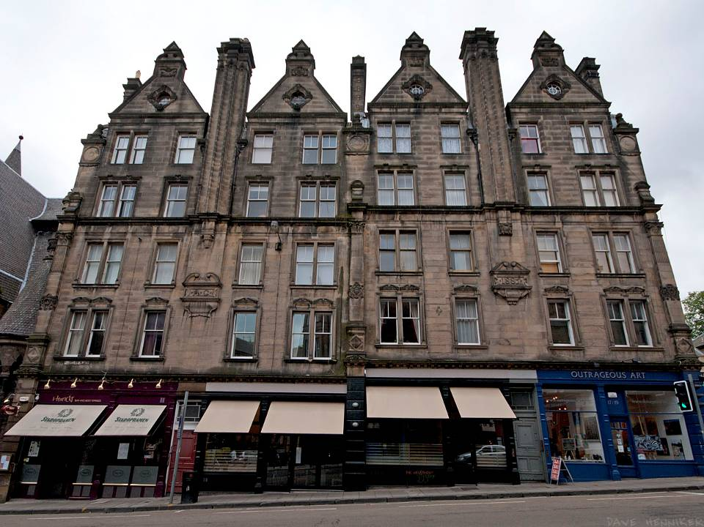
Henniker.org.uk
Notes:
Scotland is the only place in the English speaking world where "tenement" is not (normally) a pejorative term
Today's city reflects the influence of the tram

Slide 33
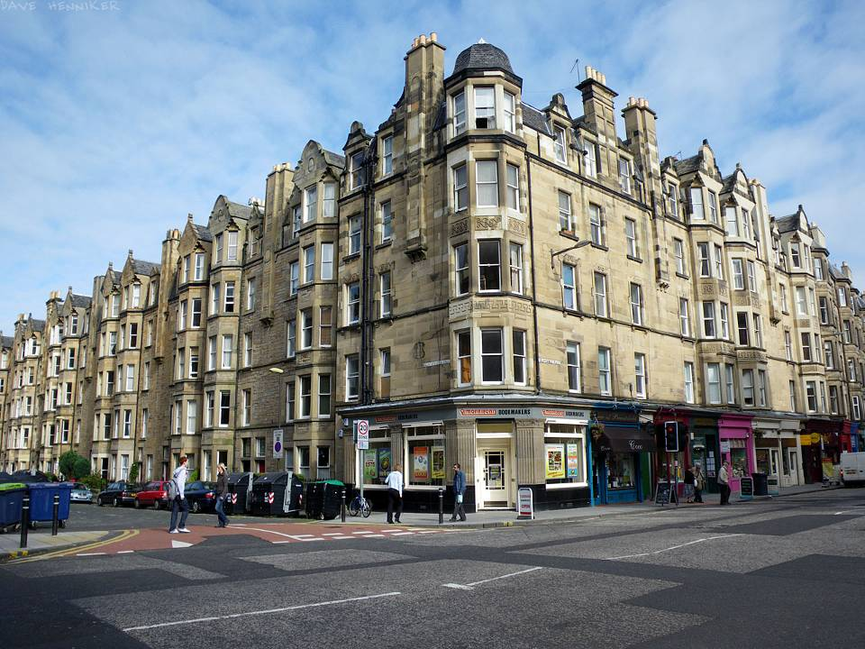
Henniker.org.uk
Notes:
That's why the shops are where they are

Slide 34
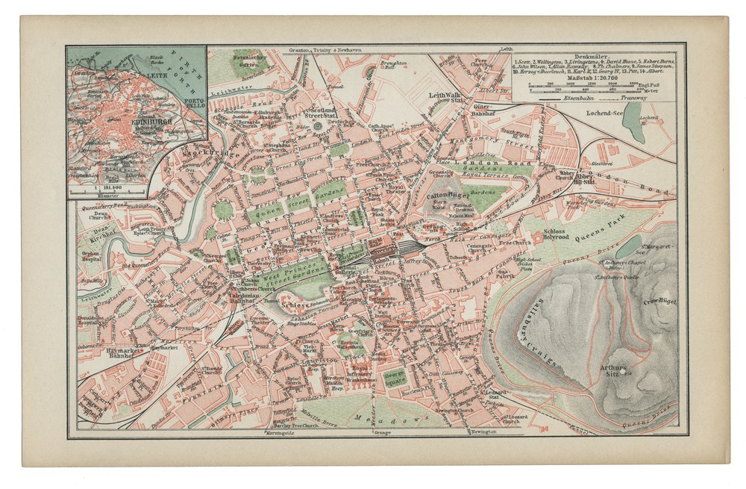

Slide 35
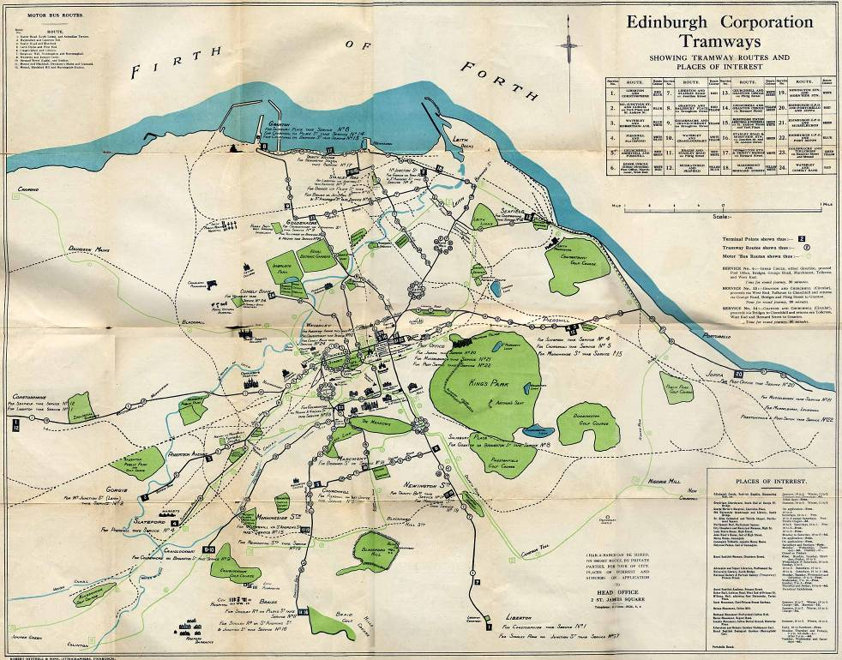

Slide 36
Notes:
Kensington High Street… excellent work by TfL elsewhere too

Slide 37
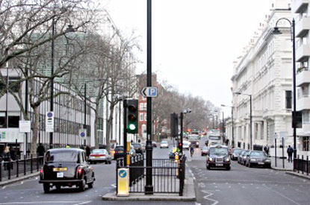
Notes:
Exhibition Road before…

Slide 38
Notes:
…after… no separation of the pavement! We’ve made it after 300ish years!

Slide 39
Notes:
We do know how to do this… this is why >25% of your discretionary retail spending is in Glasgow

Slide 40
A Case Study: The Edinburgh Tram

Slide 41
Something more?… Tramspotting (2004)
Trams will not reduce traffic congestion (by themselves)
Trams will not get that many people out of their cars (by themselves)
Trams will not transform Edinburgh’s transport system (by themselves)
(what I was arguing for was actually Eddington’s ‘sophisticated policy mix’ of new infrastructure, integrated planning, and demand restraint)
Notes:
Manchester modal shift… 1.8% car to tram!
Also 5% car to rail shift overall means doubling the size of the railways

Slide 42
What trams will and won’t do for Edinburgh
A tram that is conceived and designed solely as a mode of transport will not make a significant difference to the city’s competitiveness
… but a tram that is designed as a device to change the ways in which people perceive and connect with the city will make a big difference
… because well designed modern tramway systems are a stimulus to thinking differently about the concepts of mobility, accessibility and connectivity in the city

Slide 43
Notes:
There was some original thinking out there…

Slide 44
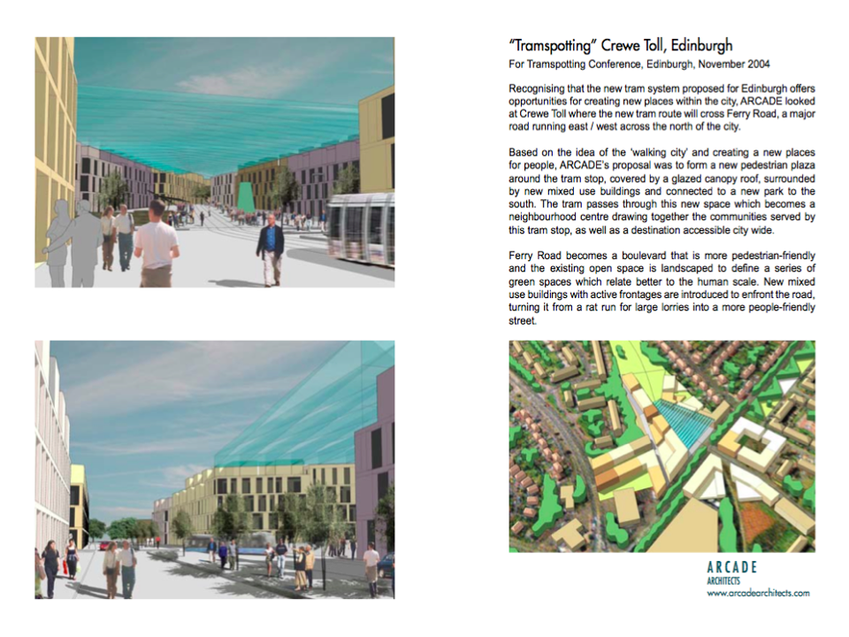
Notes:
This is almost European!

Slide 45
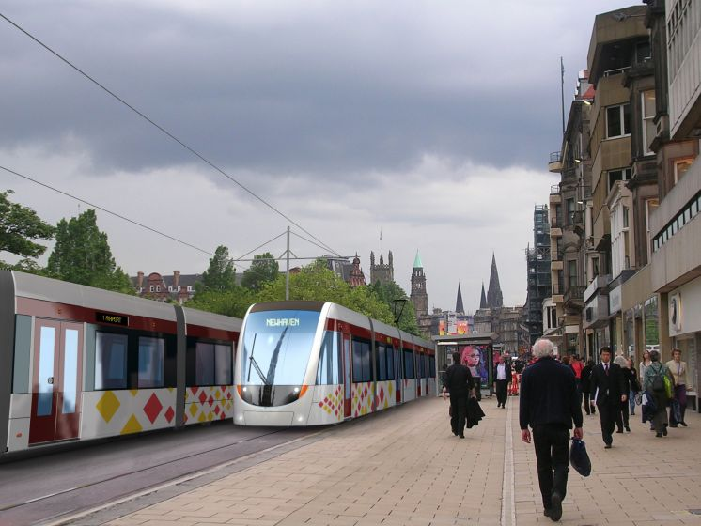
Notes:
Official artist’s impression of Princes St

Slide 46
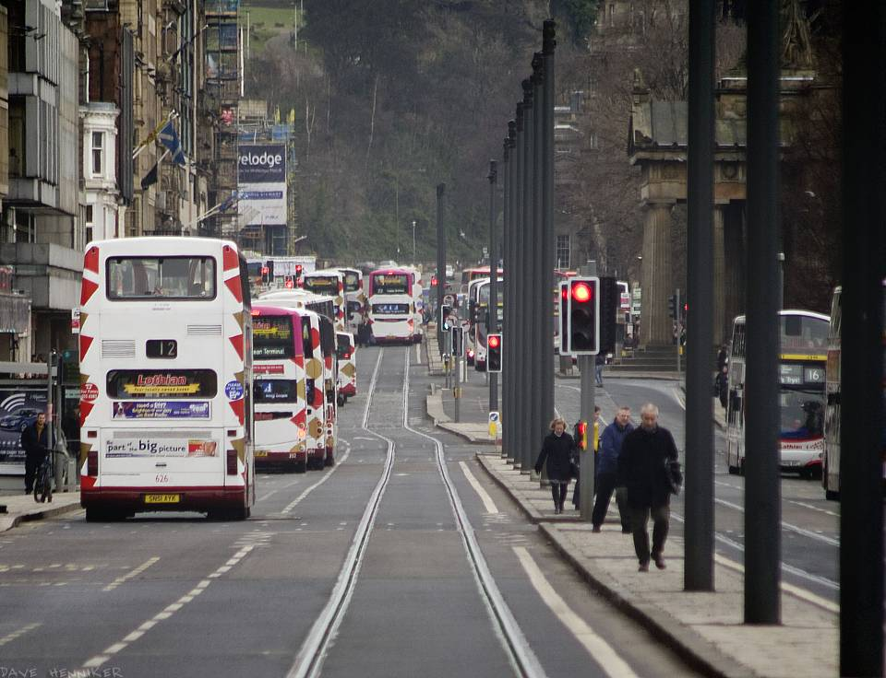
Notes:
Reality

Slide 47
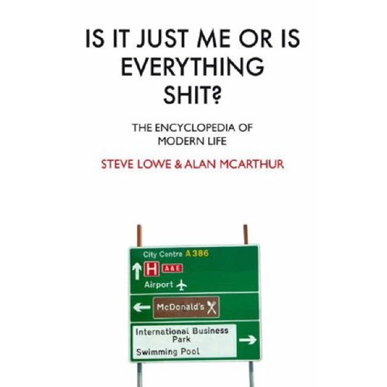
Academic critique not required…

Slide 48
Places
Notes:
France… zero to tram hero in 26 years

Slide 49
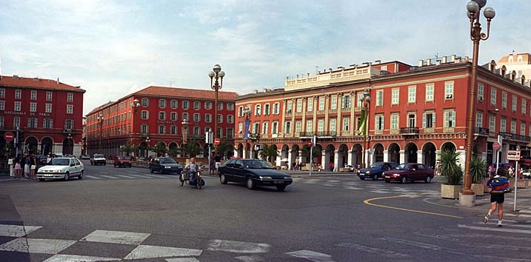
Notes:
Back to Nice… Place Massena… equivalent of the east end of Princes Street…

Slide 50
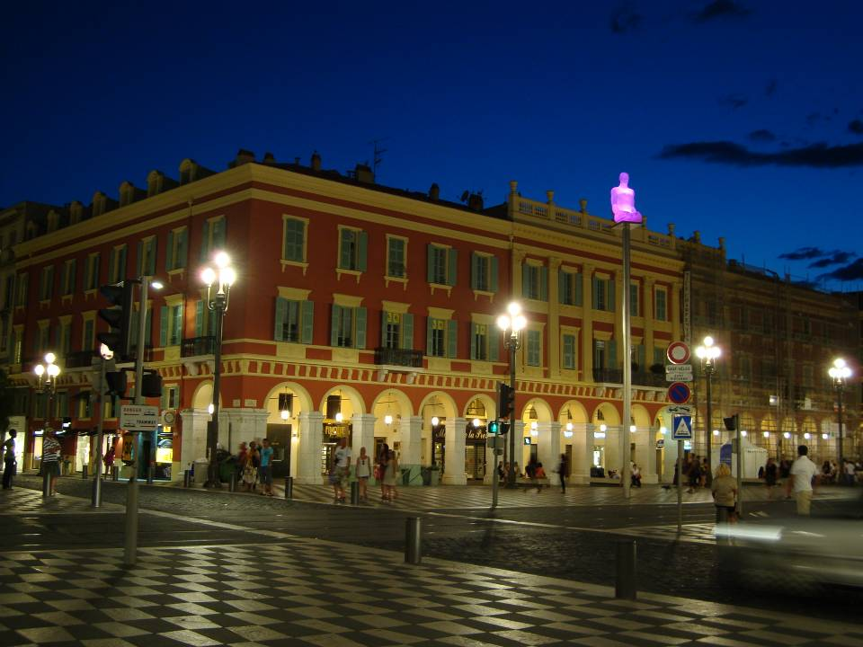
Notes:
What’s happened?

Slide 51
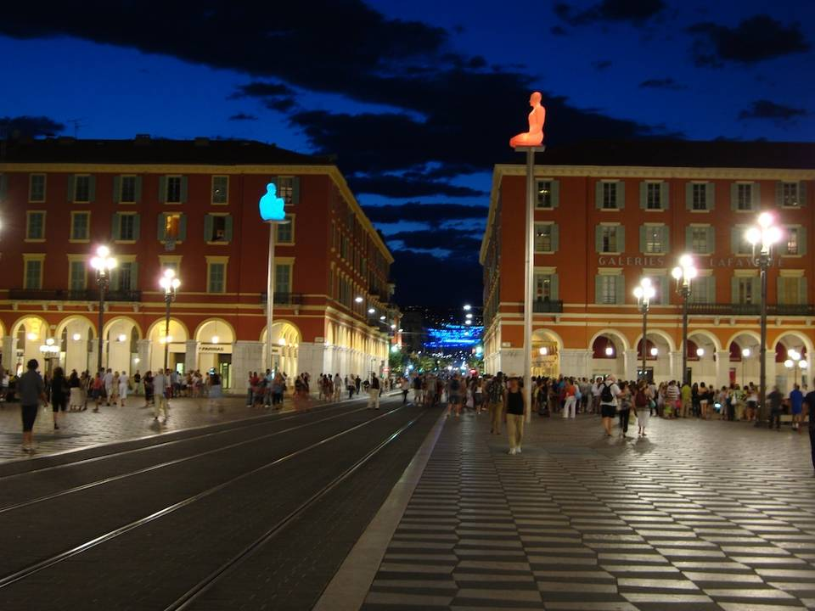
Notes:
Lots of people and activity…

Slide 52
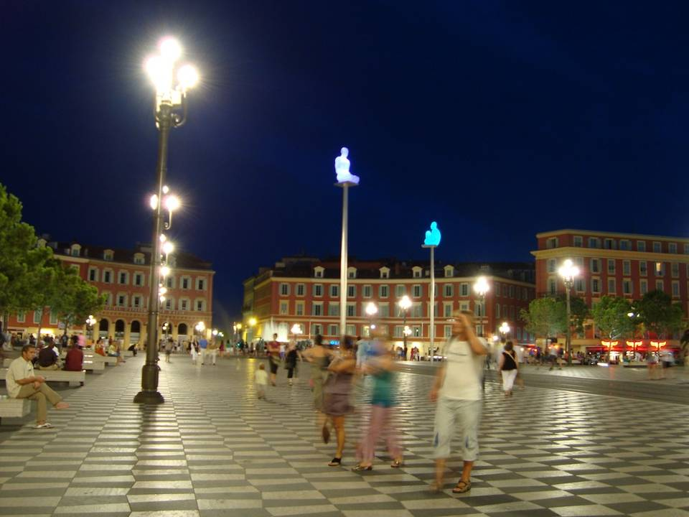
Notes:
World class public space… look at the quality of finish…

Slide 53
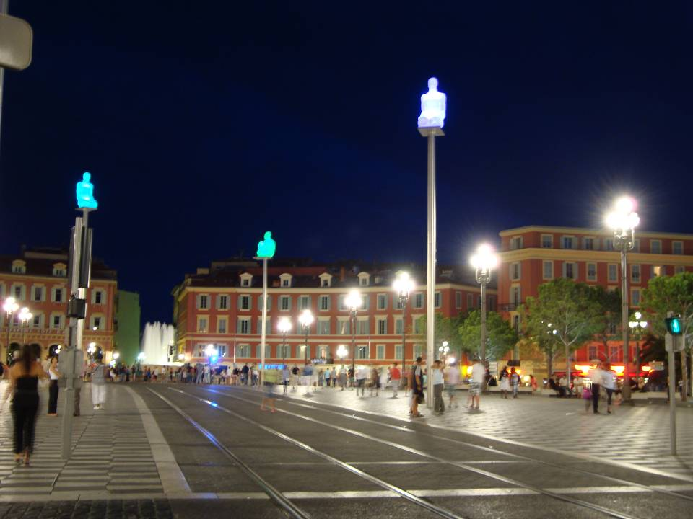
Notes:
Why so…?

Slide 54
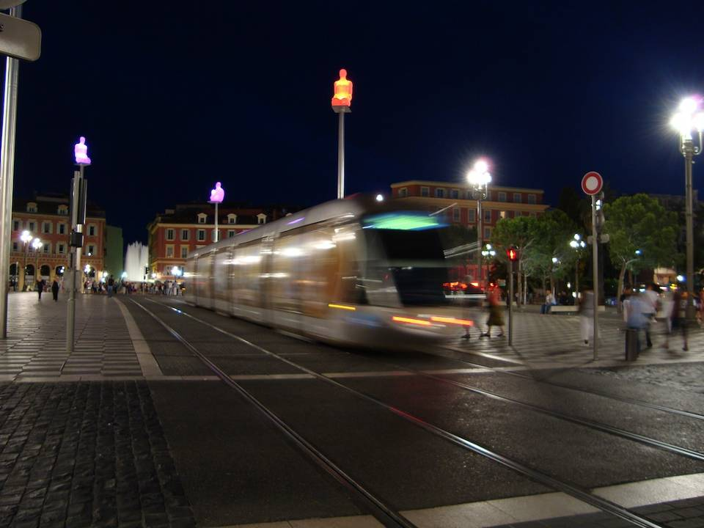
Notes:
Only now do you see the tram…

Slide 55
Notes:
Nice too had a terrible construction period… now attitudes are completely transformed.. Line 2 Expo, July 2009, construction starts 2012

Slide 56
Some conclusions…

Slide 57
Some conclusions
The current debate on ‘peak car’ is genuinely significant
We lose sight of economic, environmental and social first principles too easily
Public transport and active travel needs to be about supporting quality, productive places that people want to live in
Which means local, slower (?) and supporting people not vehicles
… but convincing people (including politicians) is not easy

Slide 58
Notes:
Tram, bike, walking…

Slide 59
Local Transport Futures
Iain Docherty
Professor of Public Policy and Governance
University of Glasgow Adam Smith Business School
Iain.Docherty@glasgow.ac.uk

