Slide 1
The UN Climate Talks in Paris
Scotland’s response and what you can do
Tom Ballantine Stop Climate Chaos Scotland

Slide 3
The Paris Talks- Background- A Quick Sketch
The world has talked about climate change- since late 19th century
1992 The United Nations Framework Convention on Climate Change (UNFCCC)
1988 Intergovernmental Panel on Climate Change (IPCC) set up by United Nations
The IPCC does not carry out its own original research
It does not monitor climate or related phenomena
It bases its assessments on the published literature.

Slide 4
5 Assessment Reports- 1990/1995/2001/2007/2014.
November 2014- IPCC Fifth Assessment Synthesis Report
The message:
‘Warming of the climate system is unequivocal’
‘It is extremely likely(that means by their definitions 95 to 100% certain) that human influence has been the dominant cause of the observed warming since the mid-20th century’
‘Each of the last 3 decades have been successively warmer at the Earth’s surface than any preceding decade since 1850’.

Slide 5
Keep the temperature rise below 2 (or should it be 1.5?) degrees centigrade
The MORE we do now the lower the temperature increase, the lower the impact.
The LESS we do now the higher the temperature, the more severe the impacts and the greater the likelihood of irreversible and unanticipated change.
‘The Tipping Point’- At a certain point the changes produced by the warming would produce more warming leading to more negative changes taking us on a downward spiral.

Slide 6
Why it matters?
The impacts getting clearer.
- Big impacts in the next 20 to 30 years. Without action:
Extreme weather events- Increased frequency, intensity, duration.
Coastal flooding and displaced people due to land loss- By 2100, hundreds of millions of people affected
Reducing yields of major crops like wheat, rice, and maize by up to 2% per decade for the rest of the century
Extinction risk for animal species- Increased
Large urban populations- Risk of severe harm
Human insecurity- Increased risks of violent conflicts due to amplified poverty and economic shocks.

Slide 7
IPCC 5th Assessment Report
The precise levels of climate change sufficient to trigger a tipping point- a threshold for abrupt and irreversible change- remain uncertain. The risks associated with crossing multiple tipping points increase with rising temperature.

Slide 8
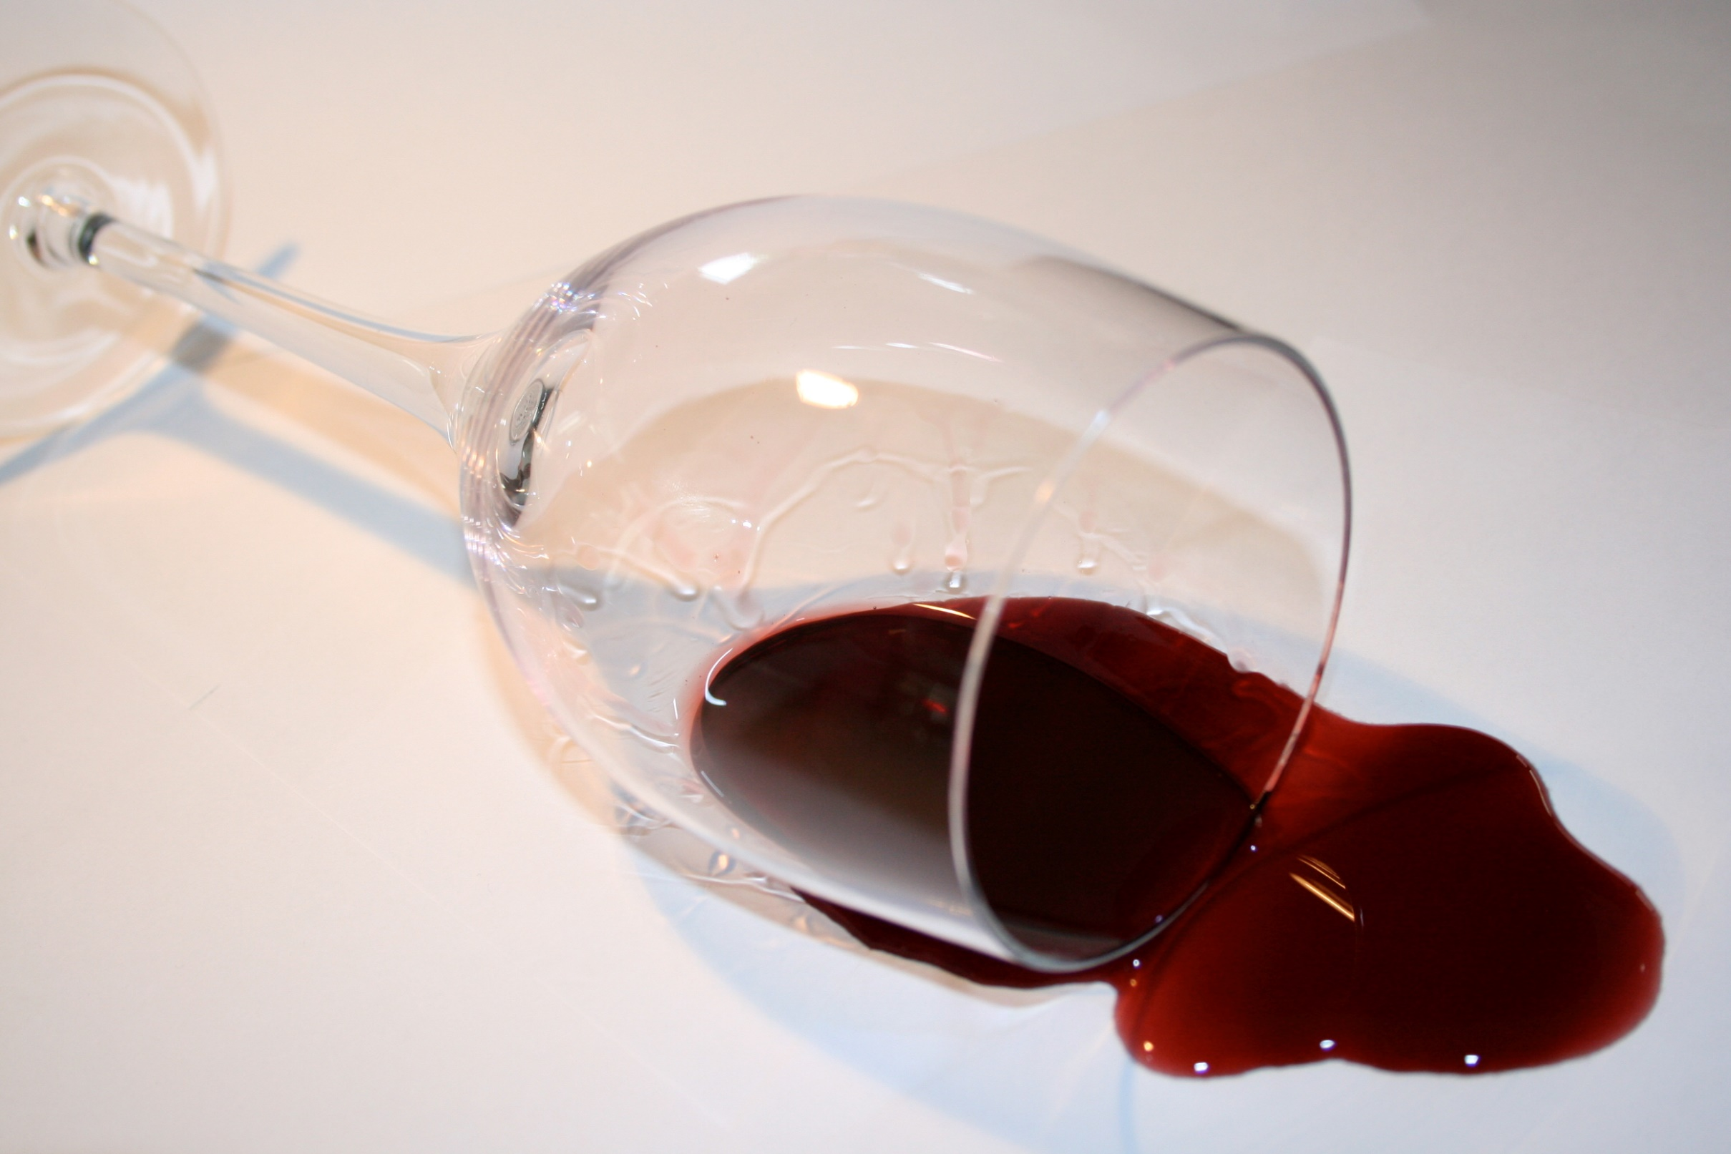

Slide 9
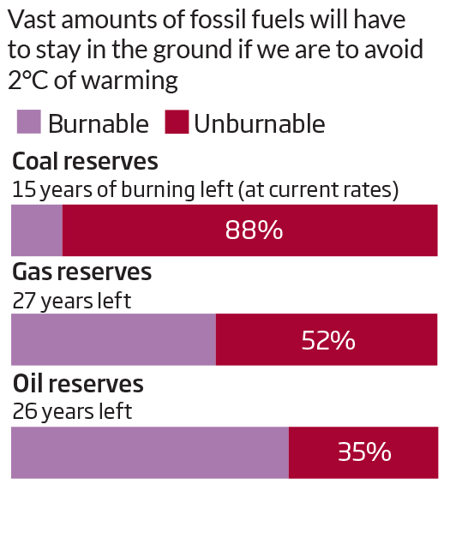

Slide 10
How is Scotland responding- at home?
Climate Change (Scotland Act) 2009
Passed unanimously.
Our targets-
2020/2050-Percentages-
42% reduction on emissions from a baseline of 1990 levels by 2020
80% by 2050.
Annual targets- tonnages- To reduce emissions to fixed lowering amounts each year.

Slide 11
Are we hitting our targets?
Look like hitting 2020 Target (Percentage)
34% reduction on emissions from 1990 levels(without adjustment for European Emissions Trading Scheme)
50% of electricity from renewables.
Missed Annual Targets (Tonnage)
A lot more needs to be done
Big infrastructure decisions being made.

Slide 12
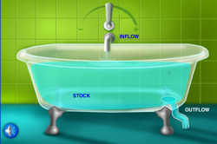

Slide 13
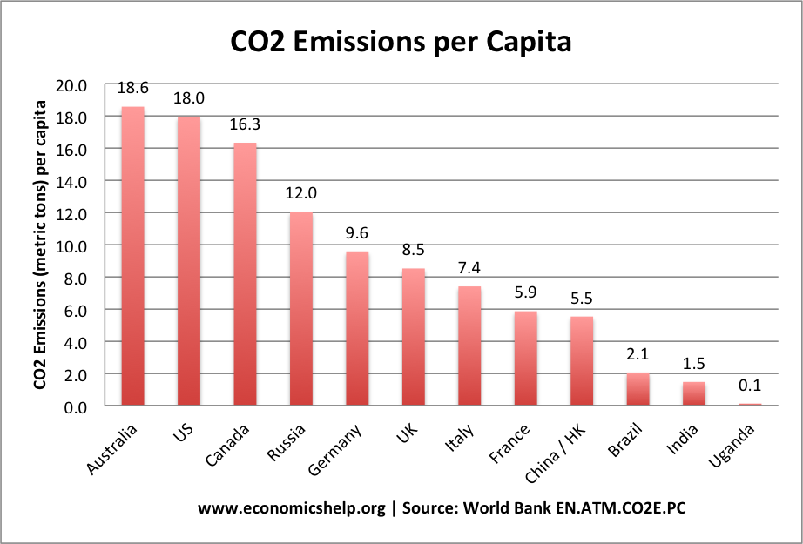

Slide 14
How is Scotland responding- abroad?
Follow our example
A prosperous, low carbon future is possible.
Climate Justice
Those least responsible for climate change paying, and will pay, the highest price.
2012 cross party support for climate justice fund.
Scottish Climate Justice Fund established.

Slide 15
What can I do?
- Consume less and re use and recycle more
Be more energy efficient in the home
Drive and fly less, more walk and cycle more
- Eat local, seasonal food.
- Support- government policies, at home and abroad, that will make
Change happen.
- Support- Rally 28th November Edinburgh- Scotland’s Climate March 12 noon the Meadows.

Slide 17
The Agreement SNP/Labour/Conservatives/Liberal Democrats/Greens
‘We commit to making each of our party manifestos for the 2016 Holyrood election consistent with delivering the ambitions of Scotland’s Climate Change Act’
Electricity generation, transport, energy efficiency(renewable heat), food sector, climate justice fund.

Slide 18
Stop Climate Chaos Scotland Manifesto for 2016
Make energy efficiency of Scotland’s homes a National Infrastructure Project
Commit to and deliver a Warm Homes Act
Build the foundations for a Low carbon Scotland through capital investment decisions
A meaningful shift from private car to public transport and active travel
Use new Air Passenger Duty to cut climate emissions
Reinforce Scotland’s support for climate justice
Commit to ambitious Land Use Strategy Action Plan

Slide 19
Back to the big picture- Is Paris the last chance?
The UN process is not perfect- but:
An important moment- a key step on the way
- Agree binding ambitious targets
Demand a plan/ policy to meet those targets
Delivery of action

Slide 20
The critical question
In the light of climate science the question is
Not will things change?
The critical question is will things change fast enough?

Slide 21
So where are we now in November for Paris in December?
The fault lines-
developed versus developing nations- Converge and contract
levels of commitment
finance for adaptation
binding/non-binding.

Slide 22
What is on the table in advance of Paris?
Intended Nationally Determined Contributions (INDCs)
Still produce a global warming above the 2°C limit (2.7°C).
If INDCs for 2025 and 2030 are not ambitious enough, will it be possible to catch up later?
The weaker it is the more difficult it becomes to catch up
Draft text
55 pages and 1,490 brackets.

Slide 23
What can we hope for? What can we aim for?
Binding
Funding for adaptation
Review process
Stronger commitments
BUT
It could all fall apart

Slide 24
Not an issue for someone else, somewhere else, sometime else.
An issue for everyone, here and now
28th November march –Scotland’s Climate March 12 noon Meadows
12 December Paris

Slide 25
There is an alternative, positive future if we act now:
With multiple benefits for health, happiness and prosperity
With fairness- The world’s poorest people will be hit hardest. They deserve our action
- With a viable planet for our children and future generations- They deserve our action.

Slide 26
‘Act as if what you do makes a difference. It does’.
William James

