Slide 1
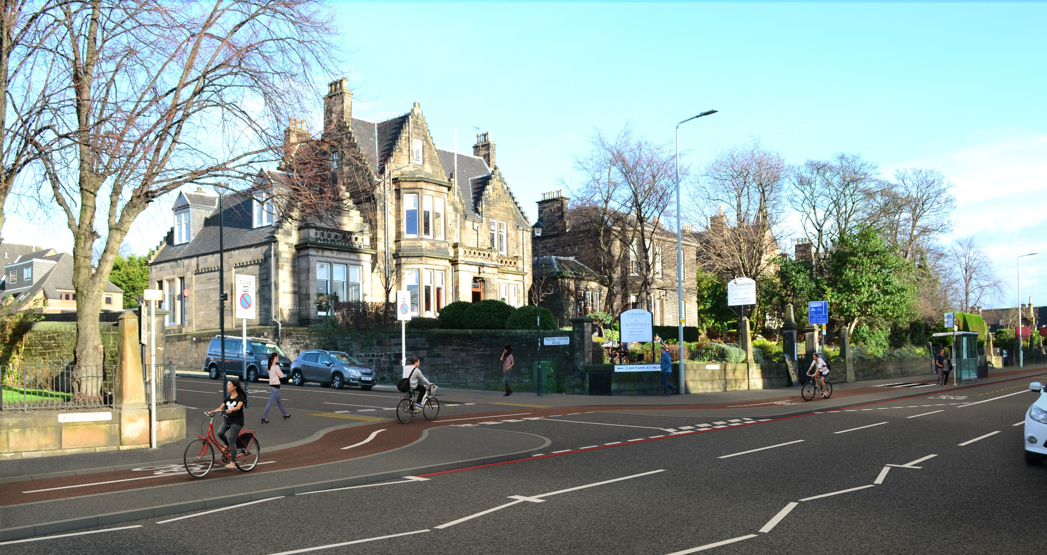
Transport Convenor, Lesley Macinnes Cycling Update SPOKES Autumn Meeting 2017

Slide 2
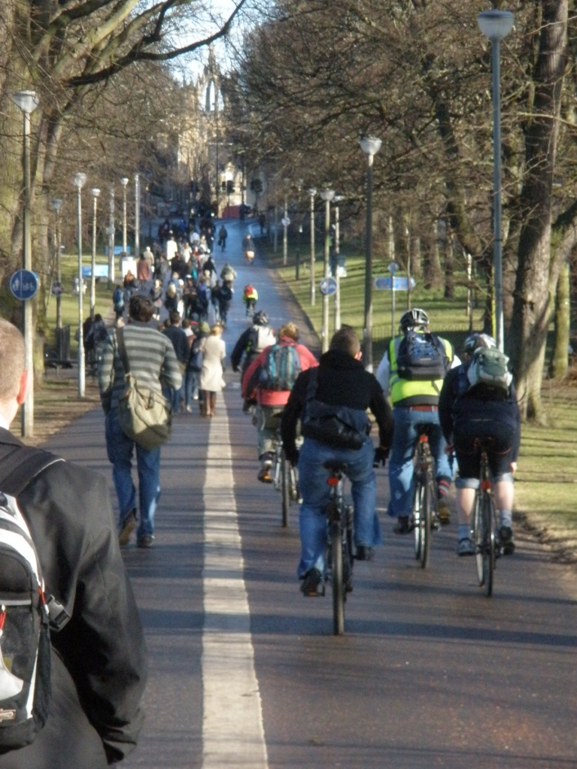
More people cycling in Edinburgh and more investment
Cycling levels
7.3% of journeys to work by bike in 2015 ª
50% increase in total number of cycle trips 2011 to 2015 ^{b}
More investment
5% transport budget in 2012-13
Rising by 1% p/a
10% in 2017-18
a= 2011 census factored by automatic counts
b = automatic counts

Slide 3
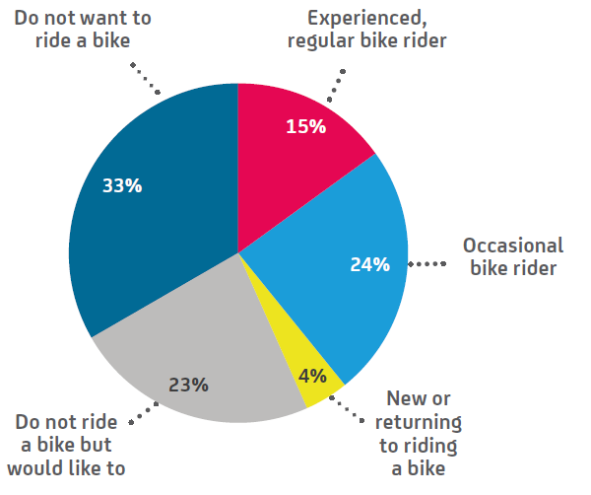
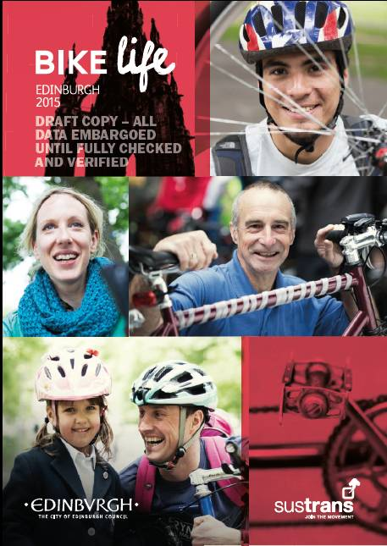
Potential for increased cycling: perceptions
Answers to ‘How do you see yourself?’ question in “BikeLife”

Slide 4
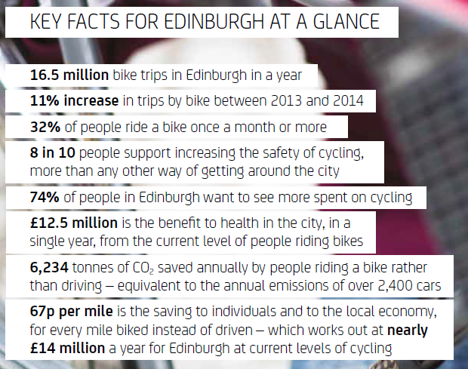
Bike Life 2015
Extract from Edinburgh Bike Life Report 2015; City of Edinburgh Council and Sustrans

Slide 5
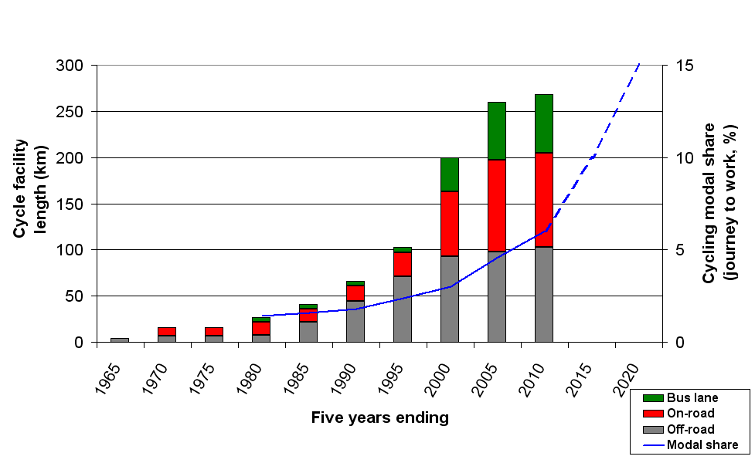
Cycling growth and infrastructure
2020 target
7.3%
2015

Slide 6
Key Achievements in 2016/17

Slide 7
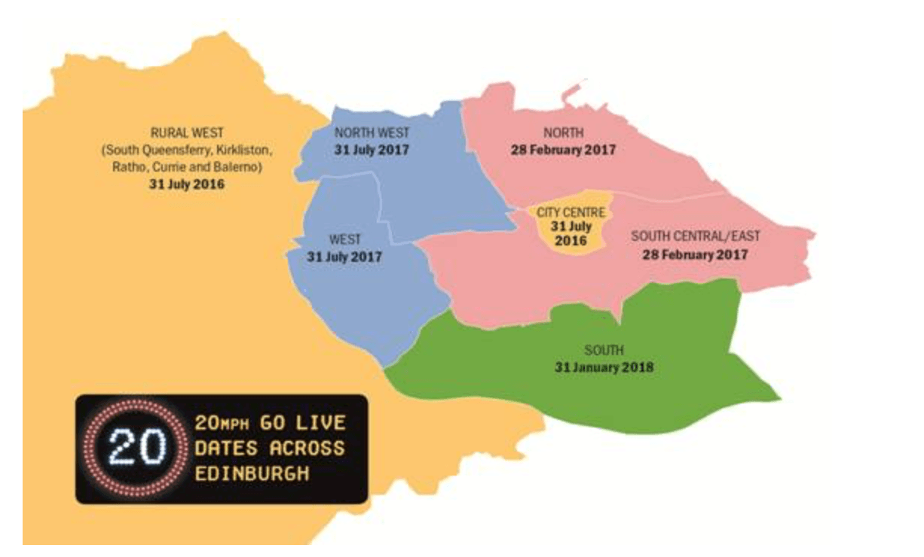
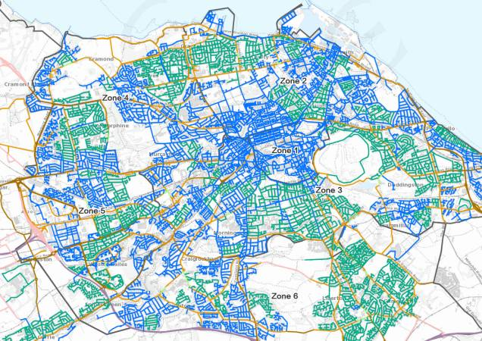
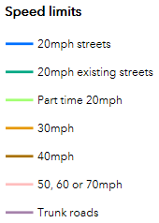
20mph Speed Limit
About half of the Scheme delivered (Phases 1 and 2 )
Phase 3 underway (from Aug 2017)

Slide 8
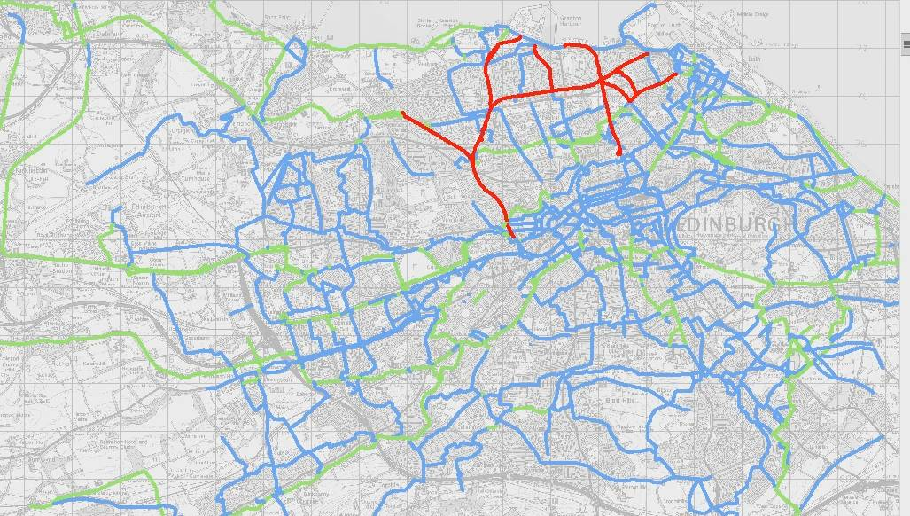
Construction in 2016/2017
Built 2016-17
Existing
Future routes
Innocent Railway Lighting
A8 upgrades, phase 2
Newhaven Ramp at Lindsay Rd
Gyle park path and flooding improvements
Over 300 public cycle parking spaces (2015-17) – City wide
£900k North Edinburgh Path Network improvements – due Winter 2017/18

Slide 9
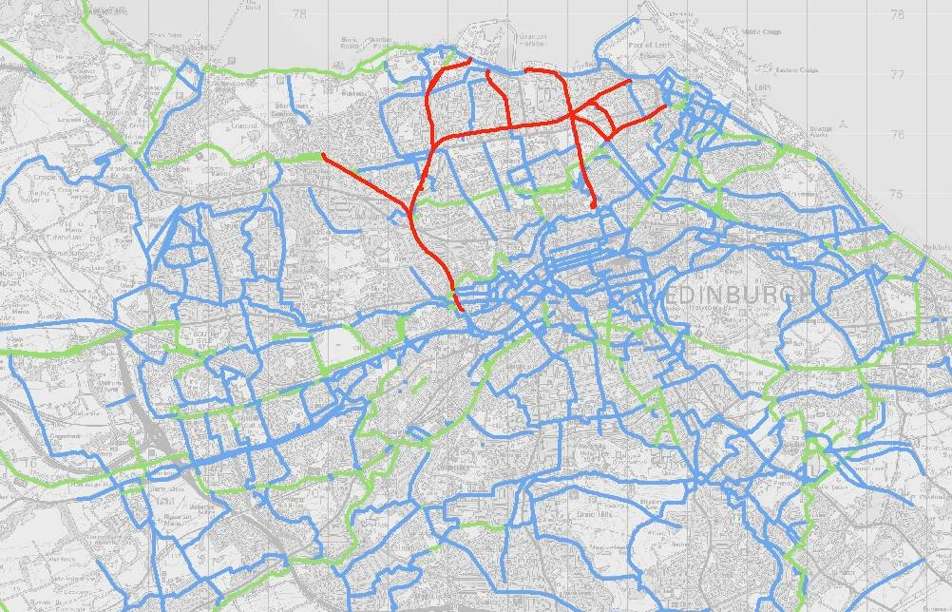
Design work 2017 – QuietRoutes Network
Designed 2017
Existing
Future routes
NCN 1 City centre West East Link
QR 8 Roseburn - Edinburgh Pk
QR6 Newington - City centre
QR30 Holyrood Park - King’s Buildings
QR20 Inverleith – Restalrig
QR61 Gilmerton – Niddrie
QR 11-14 North Edinburgh Path Network
QR13 Lower Granton Road
QR50 Davidson Mains Park

Slide 10
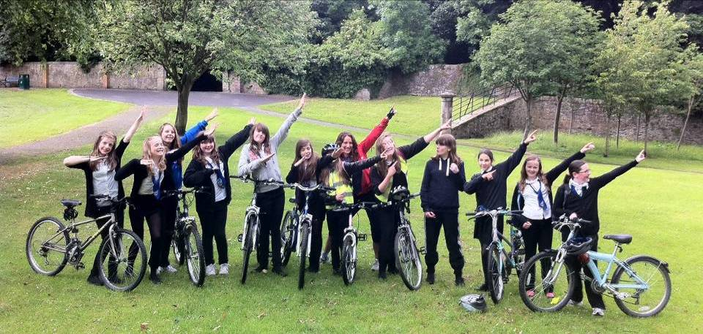
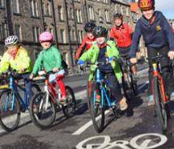
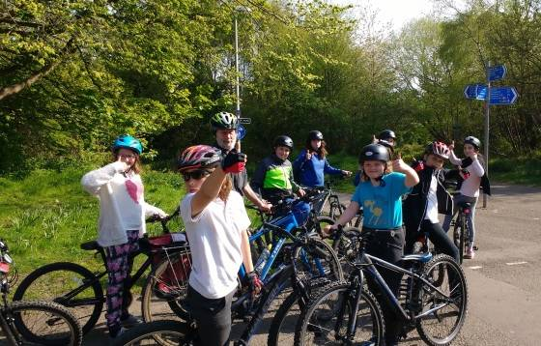
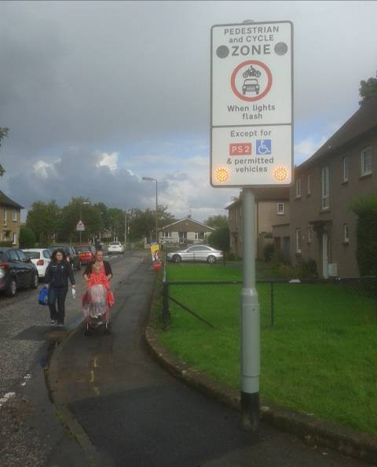
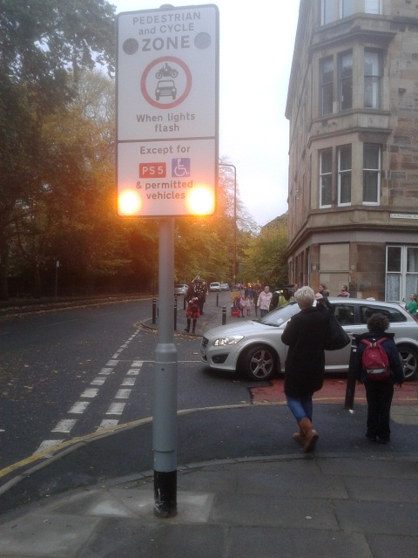
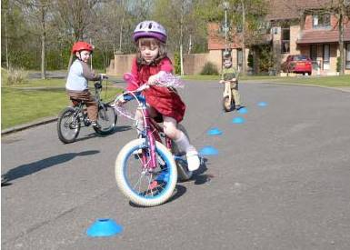
Award winning ‘School Streets’

Slide 11
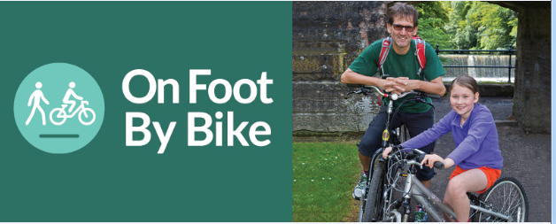
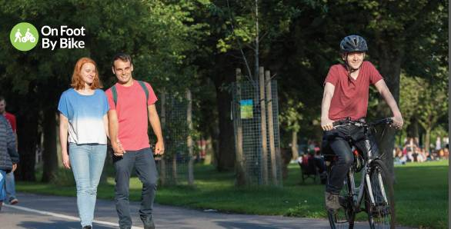
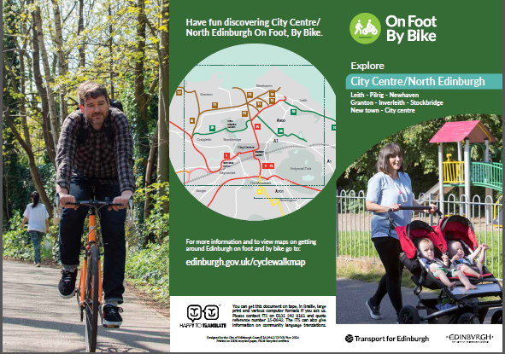
Marketing & Behaviour Change
Strategic promotion of cycling
Focus Groups helped test branding and naming
Household Survey helped identify target audiences
Feedback taken on board and designs altered
New imagery and messaging has been used to help target new demographics

Slide 12
What is coming in 2017-19

Slide 13
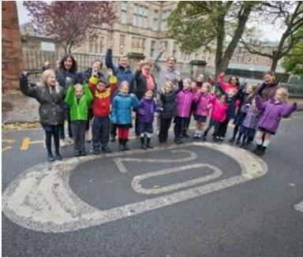
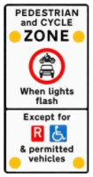
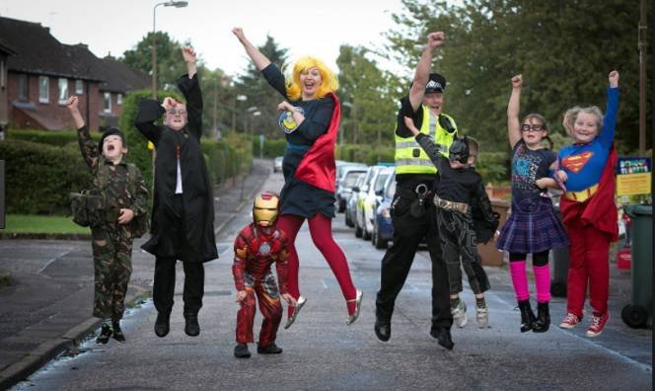
Completion of 20mph project 2018
Schools Streets – additional schools to be added in 2018

Slide 14
Tram – cycling improvements
3 Phases
Phase 1
Signs requesting that cyclists are given space
Marked cycle lane crossings of tram tracks
Implemented October 2017
Awareness campaign for cyclists and motorists
Phase 2
More Advanced Stop Lines and awareness campaigns
Aim to implement by March/April 2018
Phase 3
Improve cycle crossings and desire lines at Edinburgh Park Tram Stop
Improved cycle crossing of tram line at junctions of Princes St x S. St Andrew
Improved alignment of cycle lane outside Haymarket Station
Aim to implement by Autumn 2018

Slide 15
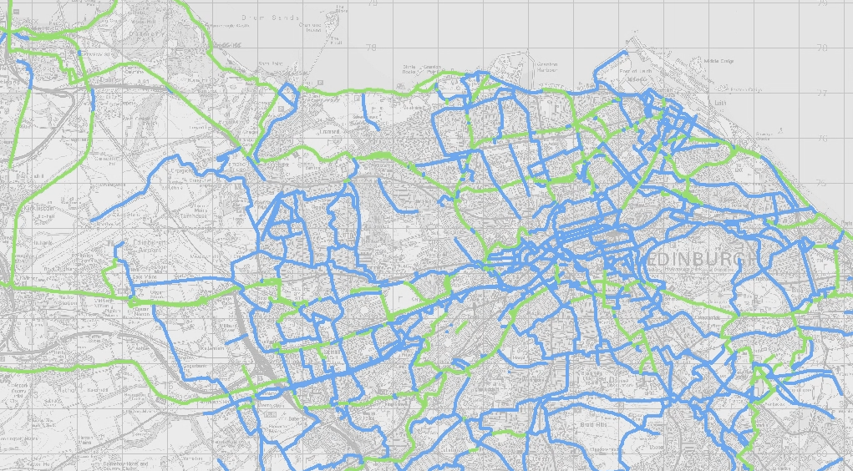
Construction 2018-19 - QuietRoutes
Build 2018-19
Existing
Future routes
Roseburn to Edinburgh Park (QR 8)
Lower Granton Road Path (QR 12)
Davidson Mains Park Path (QR 50)
Grange Road Crossings (QR 6)
A8 Cyclepath (QR 9)

Slide 16
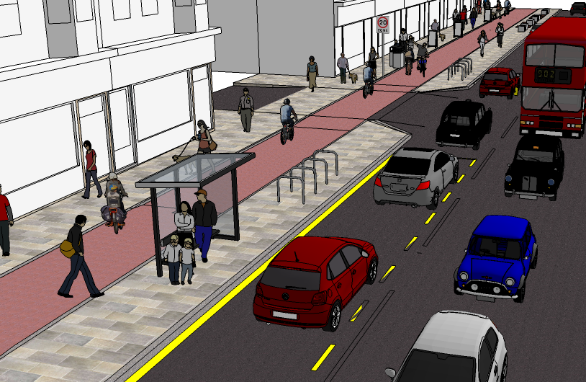
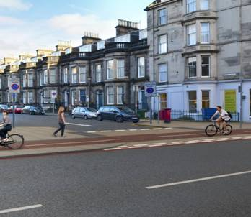
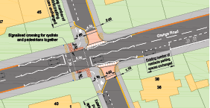
Design work (2017-19): 2 key focuses
Major City centre projects
Connecting up the QuietRoutes Network

Slide 17
City Centre West East Link
Preliminary design approved by Committee – Dec 2016
Community Liaison officer appointed
Further consultation completed and detailed design progressing
TRO process is beginning
Detailed design sections 2 & 3
Aim for construction to commence 2018-19

Slide 18
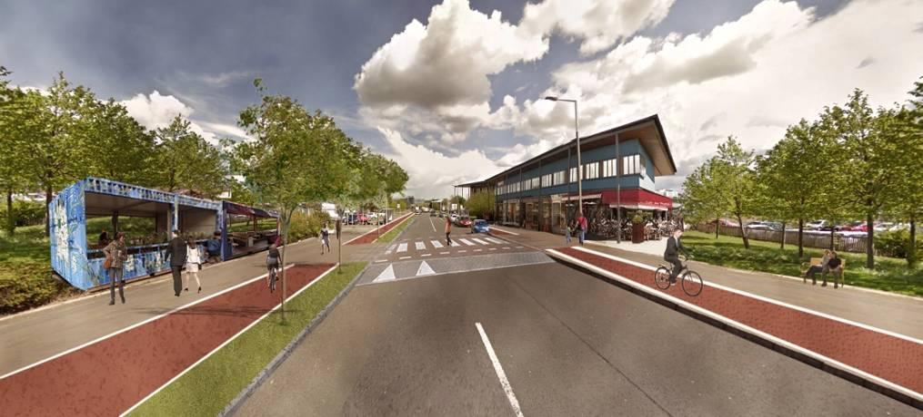
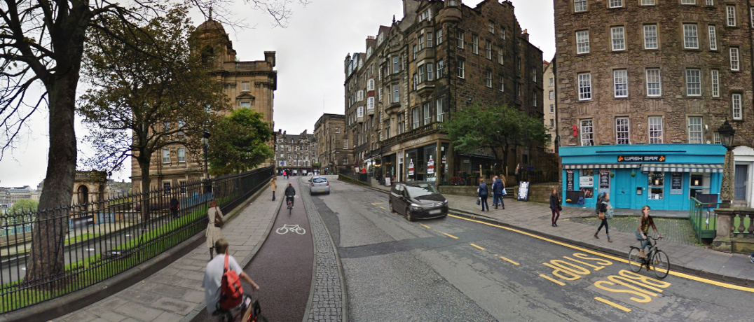
Community Links PLUS
Two winning bids!
1. West Edinburgh Active Travel Network
Segregated cycleways and cycle paths to and through to Edinburgh Park and the Gyle.
2. Meadows to George Street
Segregated cycling infrastructure linking to the City centre. Improvement to key public spaces

Slide 19
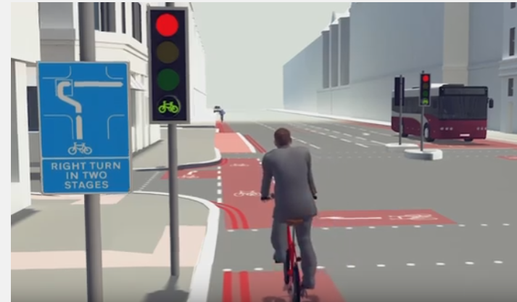
Leith Walk, Picardy Place, Leith St
Construct in 2018:
Leith Walk up to MacDonald Road (full segregation)
Leith Street to Calton Road (full segregation)
Design in 2018/19:
Leith Walk (McDonald Road to Picardy Place)
George Street (Preliminary design)
Picardy Place – further consultation underway

Slide 20
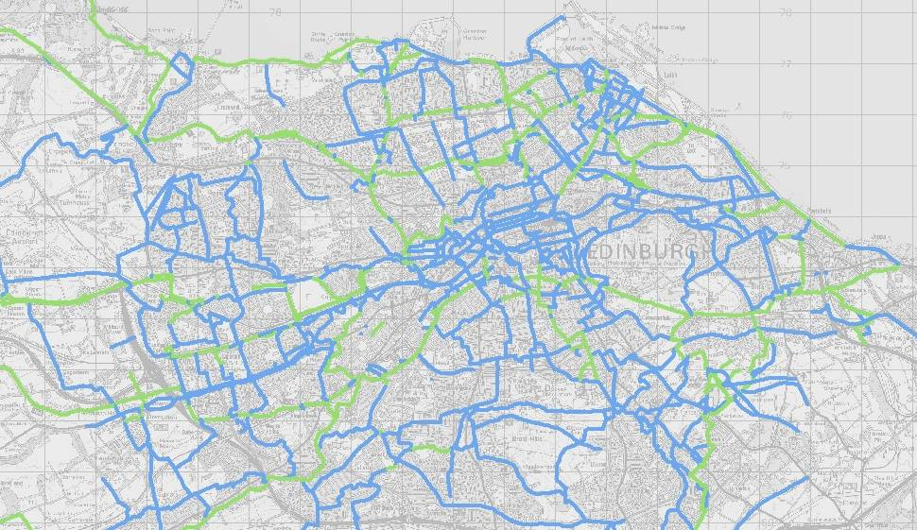
Design 2018-19: network connections
Design 2018-19
Existing
Future routes
-
Holyrood Park, QR5
Corstorphine - South Gyle QR9
Meadows to City centre QR6
St Leonards to Waverley Station
Meadows to Canal NCN75
Crewe Rd Sth - Orchard Brae
Dundee Street - Fountainbridge
Granton - Silverknowes QR12
A8 Cyclepath QR9
Sighthill to Union Canal
Marchmont to Kings Buildings

Slide 21
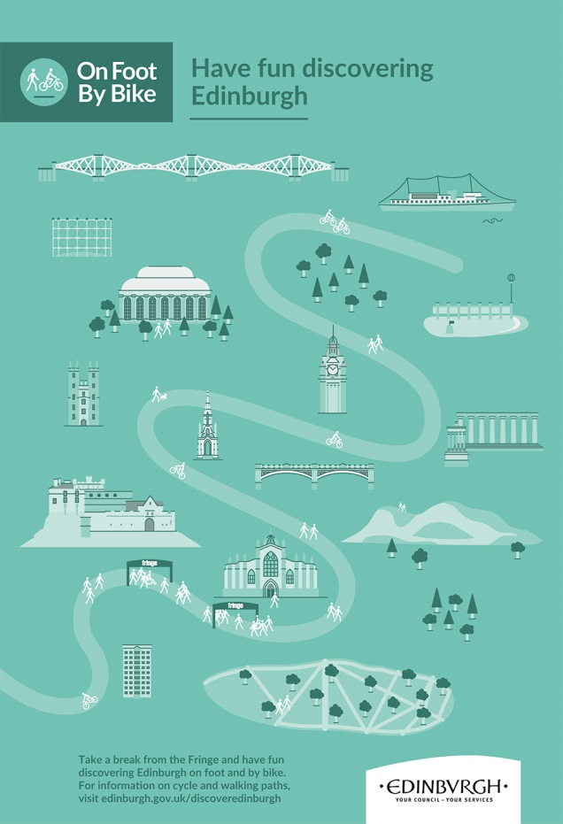
Promotion & Marketing in 2017-18
Bike Life
Biennial report on cycling in Edinburgh. Due Nov 2017
Further marketing promotion and workplace travel planning

Slide 22
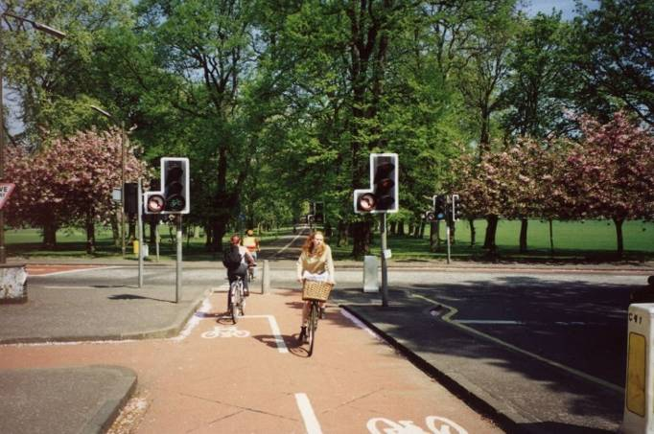
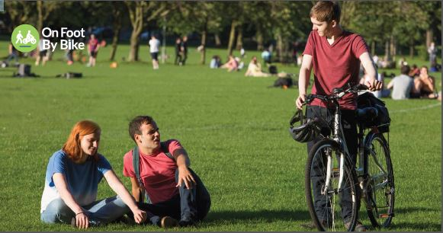
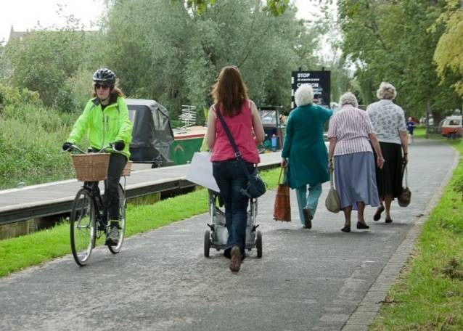
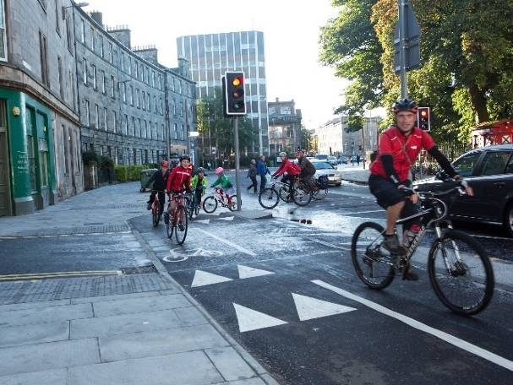
The next five years
Vision and goals for this administration
Council agreed motion – City centre transformation - traffic study and commitment to pedestrian and cycle priority

