Slide 1
Spokes 9th November 2017 Cycling Plans in the Councils West Lothian Council

Slide 2
NATIONAL CONTEXT
National Walking Strategy
Cycling Action Plan for Scotland 2017-2020
Increasing national funding for active travel

Slide 3
ACTIVE TRAVEL THEMES
Linking communities
Linking communities & commuting
Linking communities & regeneration
Strategic links, filling in gaps
Strategic links to NCN and rail access
Strategic links, development air quality
Strategic links & environmental improvements

Slide 4
PROJECT IDENTIFICATION
– Complete Missing links
– Links to NCN
– Links between communities
– Links to schools
– Links to leisure locations
– Links to town centres and retail
– Incomplete routes

Slide 5
Budget
Roads and Transportation budget
£40m 2013/14 to 2017/2018
Delivering around £3.6 million of projects

Slide 6
PROJECTS DELIVERED
Polbeth to West Calder
A89 Bangour to Tesco
Starlaw Link
Linlithgow Ramps at Canal
Linlithgow Cellars Path
Broxburn Access to the Canal

Slide 7
A89 East West Spine

Slide 8
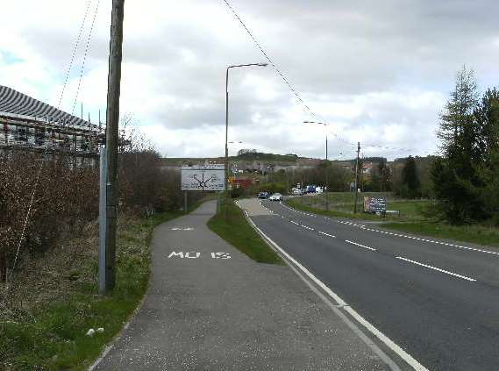
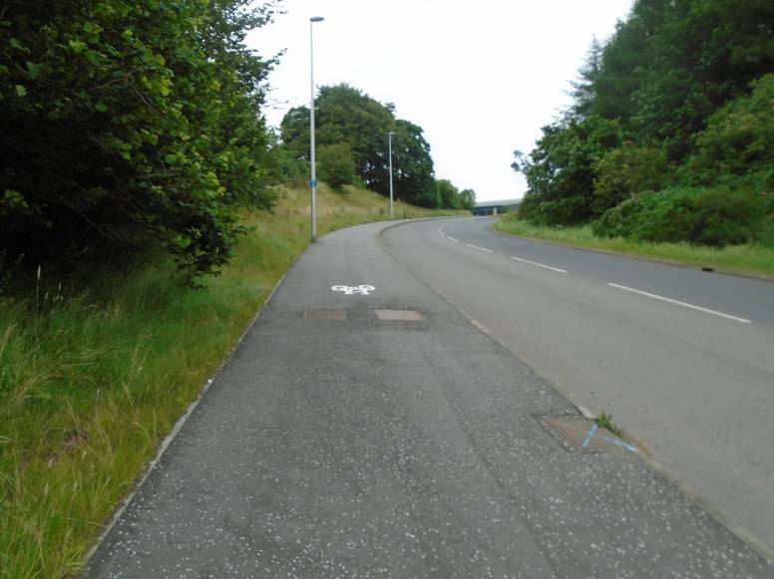
Bathgate to Livingston

Slide 9
Linlithgow at Canal

Slide 10
Local Access Linlithgow

Slide 11
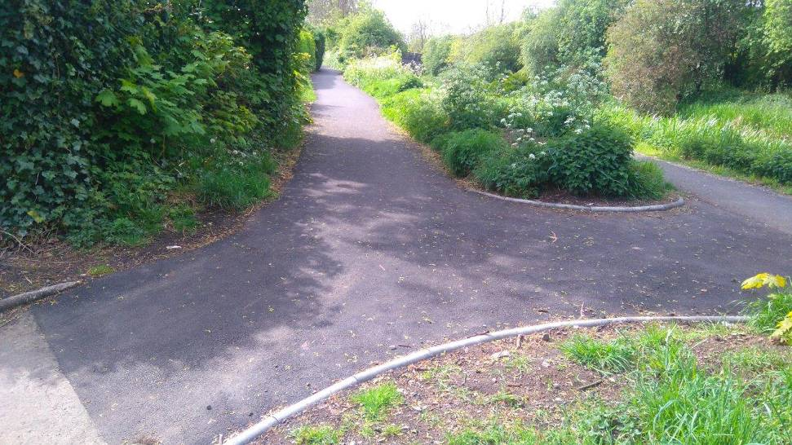
Broxburn Canal Links

Slide 12
Smarter Choices Smarter Places
Love to ride
Health Improvement Agenda
Working with Schools
Working with Employers
Creating Active travel maps for communities

Slide 13
WHAT IS NEXT?
Projects to be Delivered In West Lothian
A7066 to A706 to B7066
Whitburn to Armadale
Fauldhouse to Stoneyburn
Blackburn to Bathgate Corridor
Bathgate Rail Station improved access
Cycle friendly routes Pilot Project

Slide 14
LOCAL AUTHORITY CONTEXT
Decreasing budgets
Increasing demands for services
Budget priorities
Consultation with communities

Slide 15
FUTURE DELIVERY
Importance of active travel funding to deliver the active travel agenda
Difficulties in match funding from decreasing budgets
Case for reduction in level of match funding reqirements?
Budget consultations – an opportunity to prioritise active travel?

