Slide 1

Transport & the new Climate Change Bill
Caroline Rance
Climate Campaigner
@carorance

Slide 2
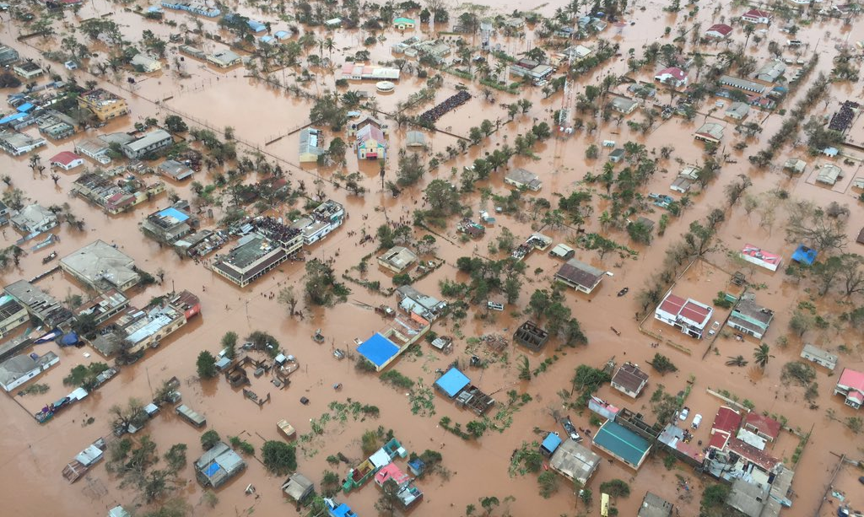

Slide 3

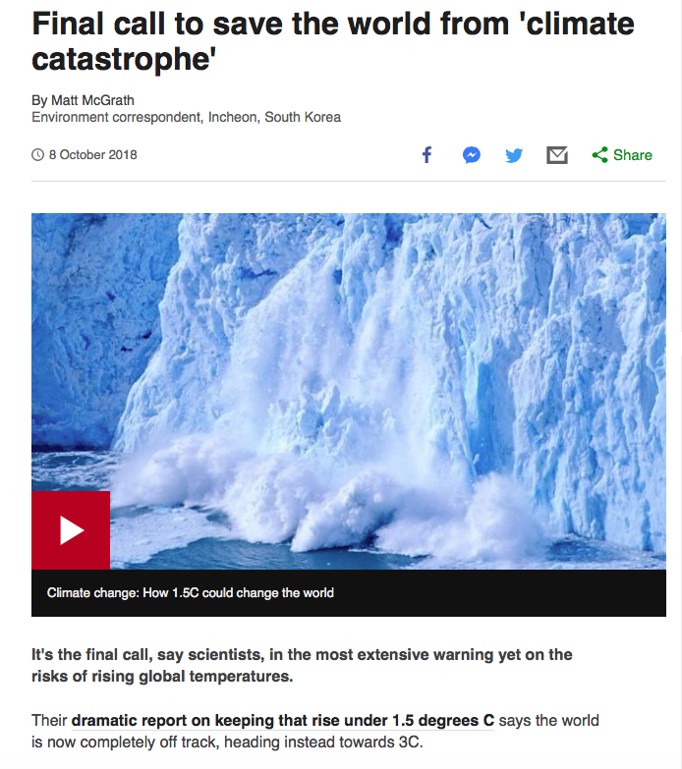

Slide 4
IPCC Special Report on 1.5ºC
“rapid and far-reaching transitions in energy, land, urban and infrastructure, including transport and buildings, and industrial systems”
“Unprecedented in scale”
“The next decade is crucial”

Slide 5
Scotland’s new Climate Change Bill
Slightly changes our climate targets
2050 target: changed from 80% to 90%
2030 target: barely changed
Doesn’t commit to any policy, no transport measures

Slide 7
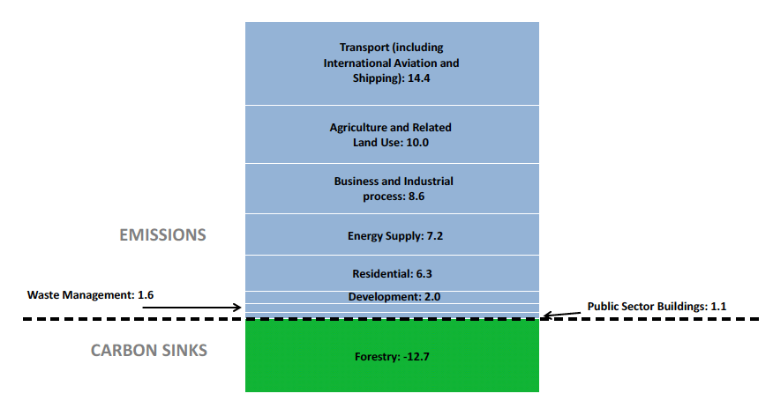
Transport is Scotland’s biggest climate emitter
37.3%

Slide 8
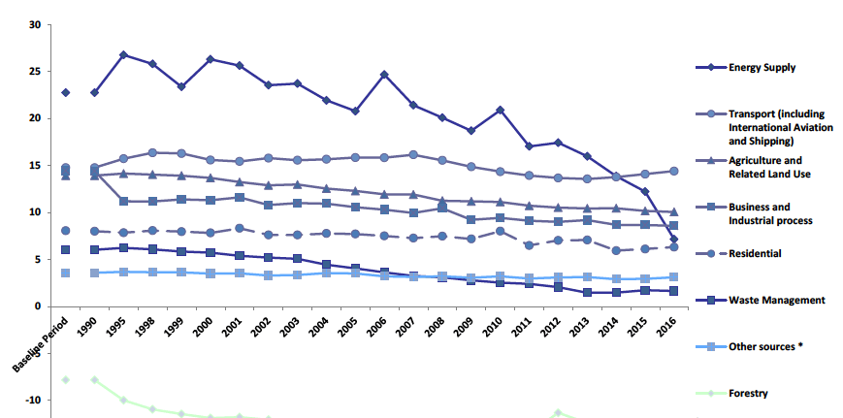
And it hasn’t improved in 25 years..
37.3%

Slide 9
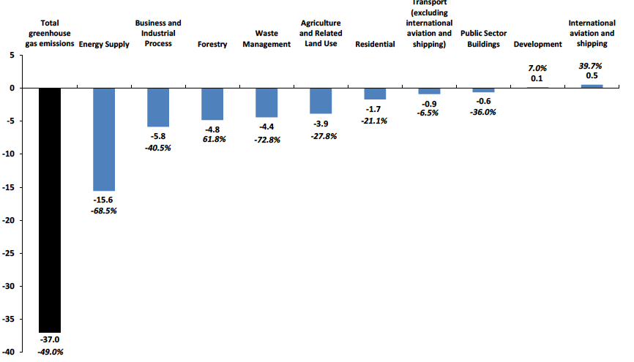
And it hasn’t improved in 25 years..
37.3%

Slide 10
What needs to happen in transport?
Phase out the need for new fossil fuel cars & vans by 2032
  Not just electric vehicles! Needs to be public transport
10% of transport budget to be spent on active travel
Deprioritise cars
  Pedestrianisation, low emission zones, enforce parking restrictions, 20mph speed limits, car free zones and days, workplace (and premises) parking levies,
Notes:
Petrol & diesel cars and vans

Slide 11
How does a Bill become law?
3 stage process
Stage 1
- Scottish Parliament’s Environment, Climate Change & Land Reform (ECCLR) committee consider the bill, taking evidence from experts & stakeholders
- ECCLR committee write a report with their recommendations
- Whole Parliament debates & votes on the Bill

Slide 12
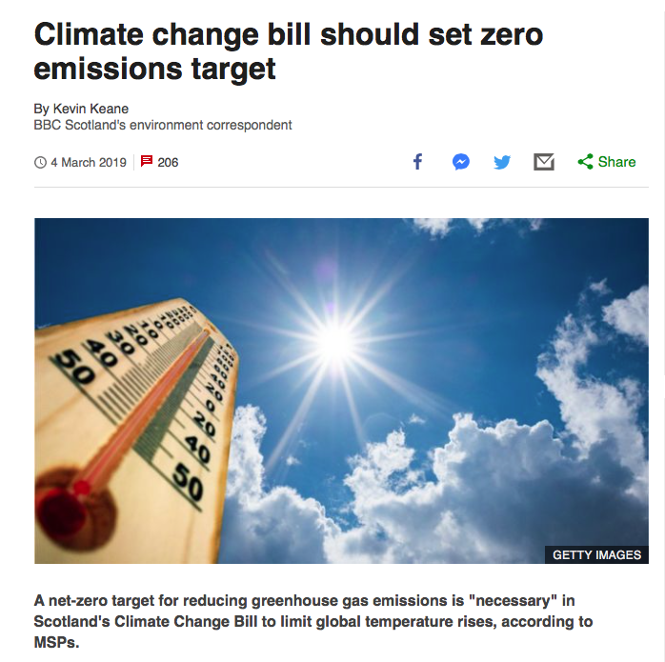
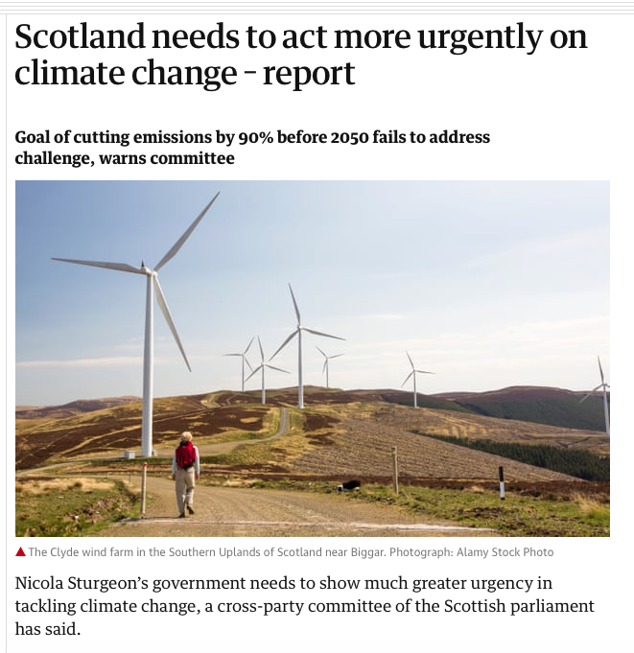

Slide 13
How does a Bill become law?
3 stage process
Stage 1
- Scottish Parliament’s Environment, Climate Change & Land Reform (ECCLR) committee consider the bill, taking evidence from experts & stakeholders
- ECCLR committee write a report with their recommendations
- Whole Parliament debates & votes on the Bill

Slide 14
Take action
Talk to your MSPs!
Tues 2nd April: - Parliament debates the Climate Bill
          - Climate rally outside Parliament! 12.30 – 2pm
Wed 22nd May: Healthy Streets event
David Hume Tower, 6.30-8.30pm
FoE Edinburgh/ Transition Edinburgh
June: Consultation on Edinburgh’s Low Emission Zone
Autumn/ Dec: Climate Bill amendments & final vote

