Slide 1
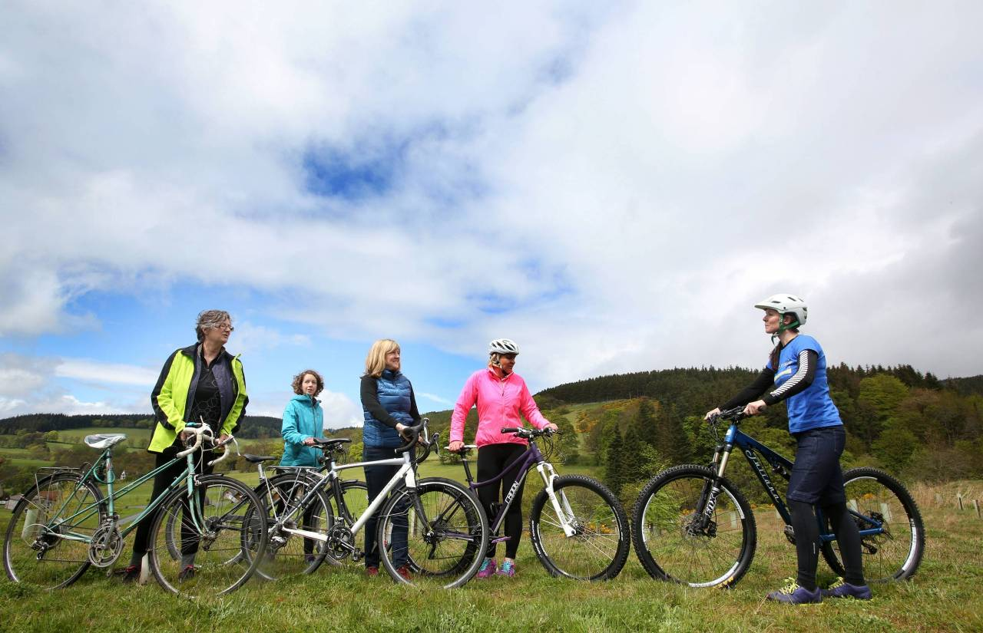
CLIMATE, CYCLING, TRANSPORT
Claudia Beamish MSP

Slide 2
NEW RESEARCH ON CLIMATE CHANGE
Moving beyond Paris Agreement 2°C focus – now the UN Intergovernmental Panel on Climate Change shows it is absolutely vital that we limit the rise to 1.5°C
1.5°C vs 2°C means:
Several hundred million fewer people exposed to climate related poverty
Proportion of the global population under water stress to be 50% lower
A projected decline of at least 70% of all coral reefs, rather than total loss

Slide 3
Climate change (Scotland) bill
Currently…
Scottish Labour
- The ECCLR committee has just released it’s Stage 1 report, which will be debated in the Chamber soon
- The Scottish Government’s proposed Bill does not include nearly enough ambition and has much room for improvement…
- Set a target for Scotland to achieve net zero greenhouse gas emissions by 2050 at the latest
- Along with a target of 77% emissions reduction by 2030 – demanding urgent action for intergenerational justice
- All accompanied by a statutory, long term, well funded, and independent Just Transition Commission

Slide 4
TRANSPORT AND CLIMATE CHANGE
- The transport sector is the heaviest emitter of greenhouse gases
- Latest Gov stats show transport emissions are damning:
- 1990 – 2016: reduced by 2.5%
- 2015 – 2016: increased by 2.3%

Slide 5
Scottish government cycling targets
- Scottish Government target is to achieve 10% of everyday journeys by bike by 2020
- Progress very slow so far, and 2018 stats show only 2% of journeys were by bike, compared to 52% by car.

Slide 6
EUROPEAN leaders
Amsterdam is home to an estimated 847,000 bikes
That’s nearly 2 per household
I went to check this out!
If we could replicate this in Scotland, it would bring multiple benefits to health, air quality, and climate change efforts.

Slide 7
CROSS PARTY efforts
- I am Co-Convenor of the Cross Party Group on Cycling, Walking, and Buses
- Working alongside Alison Johnstone (Scottish Greens) and Graham Simpson (Scottish Conservatives)
- The CPG on Cycling proposed a cycle infrastructure project award to the Government, who launched the idea from there. It is Community Links Plus now in its second year.

Slide 8
Community links plus
I visited the South City Way, the 2016 winning entry, which was given £3.25 million of Gov funding and Glasgow City Council matched the same figure.
The South City Way enables diverse communities to enjoy cycling for £3 a year hire fee.
Artist’s impression of South City Way

Slide 9
ACCESSIBILITY
2017 Transport Scotland statistics on % that cycle as their usual method of travel to work:
Men: 4% - Women: 2%
Least deprived: 6% - Most deprived 1%
Age 20-29: 4% - Age 60+: 2%
Large urban areas: 5% - Accessible rural: 1%
Cycling should be accessible for all!

Slide 10
OTHER Opportunities in legislation
Transport (Scotland) Bill
Proposed Restricted Roads (20mph Limit) (Scotland) Bill
- Currently at Stage 1
- Colin Smyth MSP is leading for Labour on areas such as:
- Defining and strengthening Low Emission Zones, particularly to deal with illegal air pollution levels
- Enabling competitive municipal bus companies
- Strengthening smart ticketing
- I am supporting Mark Ruskell MSP’s Members Bill
- A proposal for a bill to replace the current 30mph default speed limit on restricted roads with a 20mph limit.

Slide 11
Claudia.beamish.msp@parliament.scot
There are a wide range of further forward ways forward in bike/climate action; such as bike/driver education, presumed liability for safety and so much more.

