Slide 1
Where are we?
Edinburgh, with Laura Laker

Slide 2
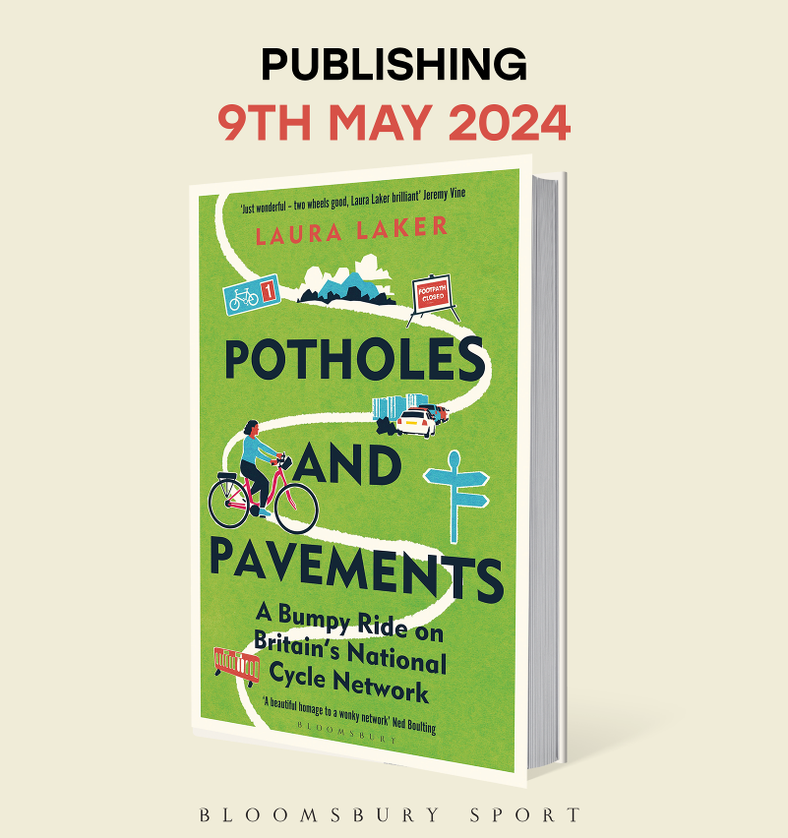
Who am I?
Laura Laker
Journalist, co-host of Streets Ahead podcast
I’ve been writing about active travel (walking and cycling) for over a decade
Written a book about the National Cycle Network, being published by Bloomsbury on 9 May

Slide 3
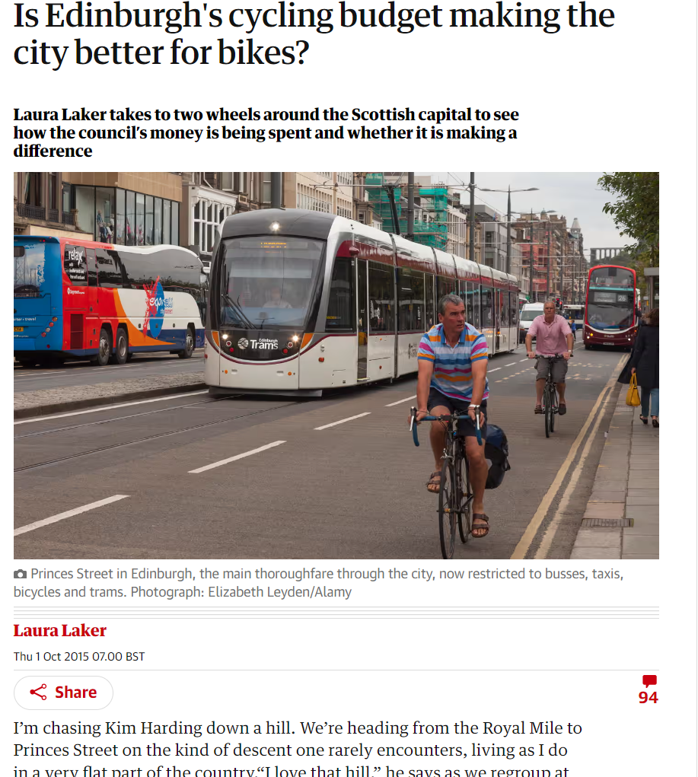
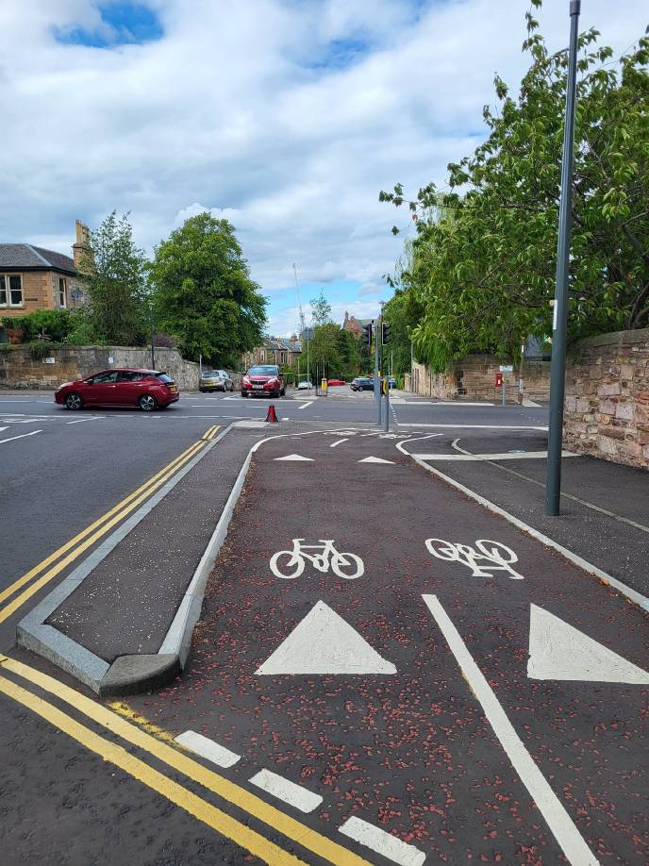
What do I know?
Nine years ago I visited Edinburgh…
Prince’s Street had a new tram
George Street had a trial cycle lane…
In 2022 I came back…
What about today?

Slide 4
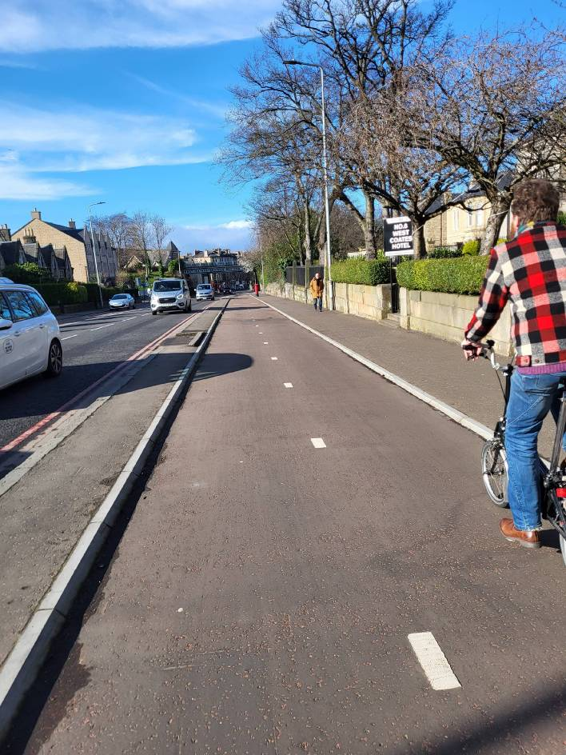
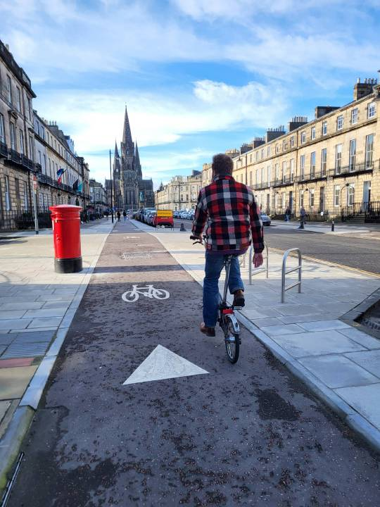
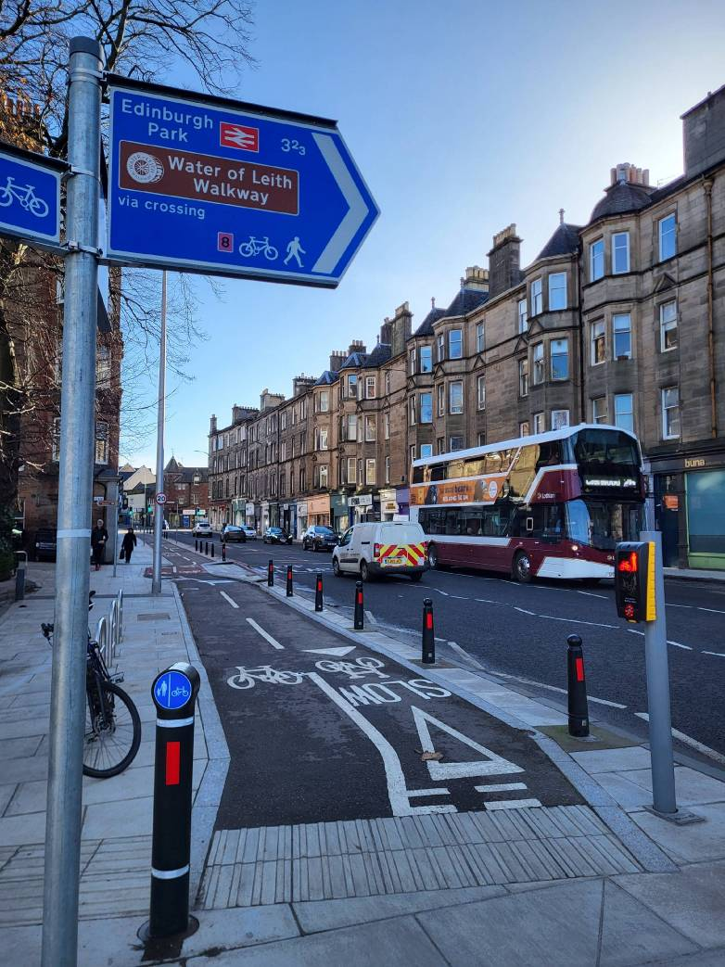
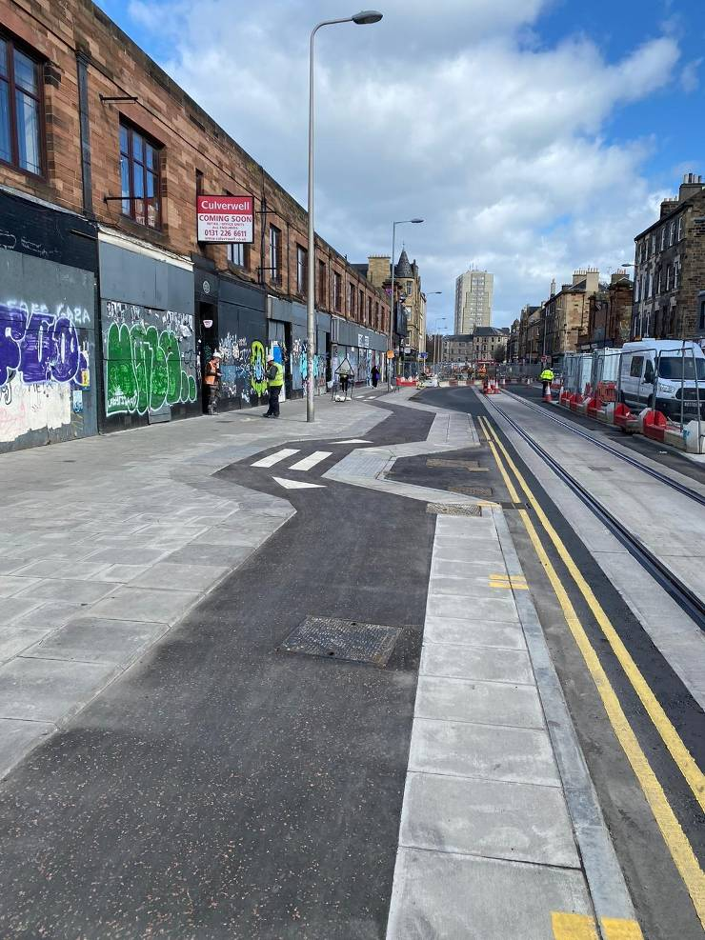
What’s changed?
Some weird stuff (Leith Walk)
Some great new bike lanes
- CCWEL
- Roseburn to Union Canal
- Leith Connections
Citywide 20mph zone
Pavement Parking ban
School streets

Slide 5
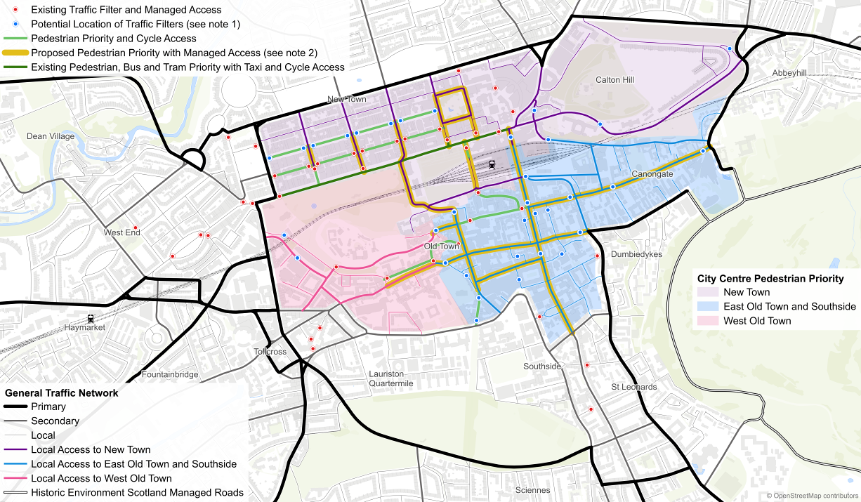
The plans…
Systematic look at the city’s transport network
Big focus on public transport (2m bus trips a week) – and walking
Three main parts that impact cycling:
Circulation plan
Active travel action plan
LTNs/20 minute neighbourhoods
Notes:
When

Slide 6
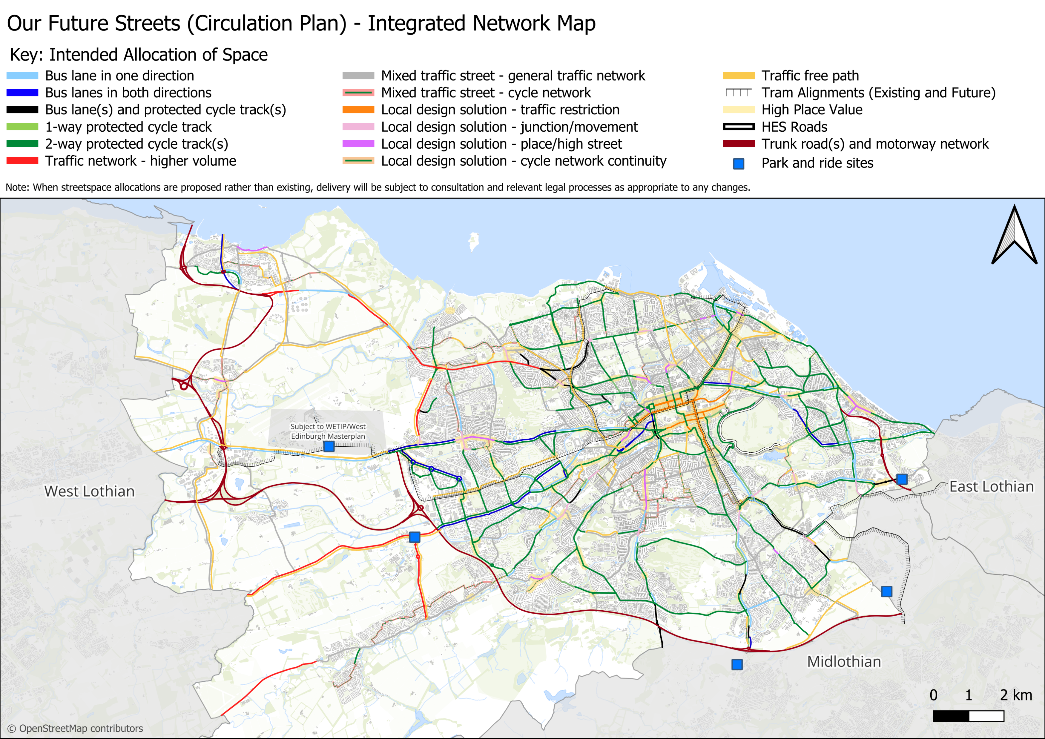
Risks/opportunities for cycling
Ghent’s circulation plan transformed a similar-sized city
Cut air pollution by 18%
5m Euro cost
Cycling increased from 22% to 37%
Car share rose from 6,000 to 20,000
20% drop in city centre traffic
Impact on deliveries
70.7 million trips of under 3 miles are driven in Edinburgh each year
Residents support cycling
26% of residents cycle at least one day per week

Slide 7
Risks/opportunities for cycling
Balancing demands
‘Each street can do one or two things well’, first and second in many cases being walking and buses
If there isn’t space on main roads, cycling is moved to the back street
We’re told Leith Walk, the absurdist compromise, won’t happen again!
Tackling through traffic where there is local support

Slide 8
Actions, not words, will be crucial
2015-2022 not much happened on the ground
2022-2024… a lot has happened
If the momentum keeps up…
Edinburgh… the next Amsterdam?
Competition from Dublin

Slide 9
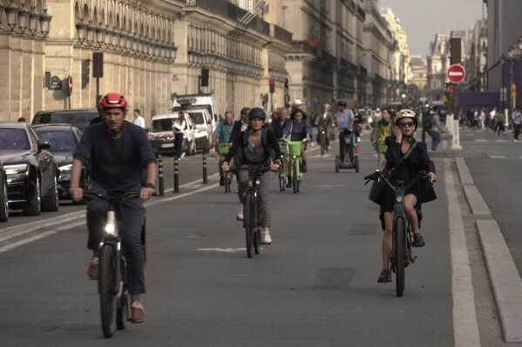
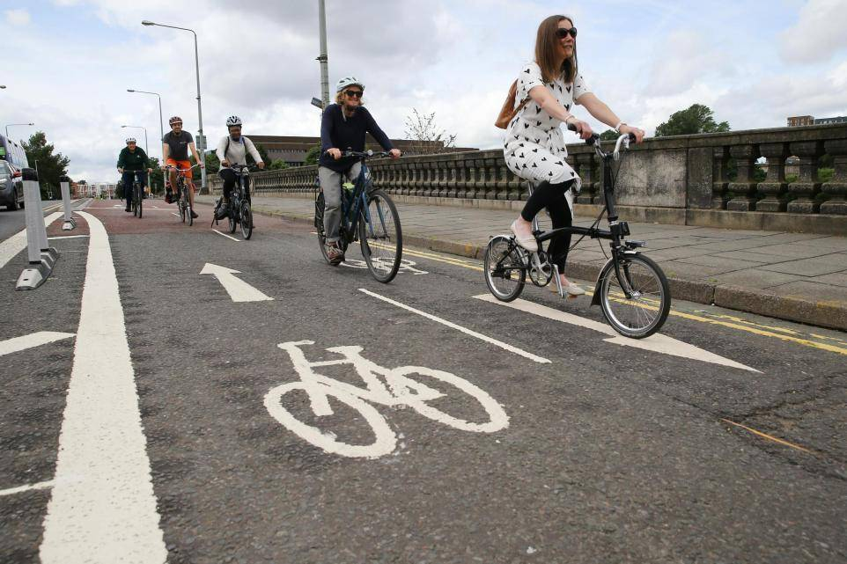
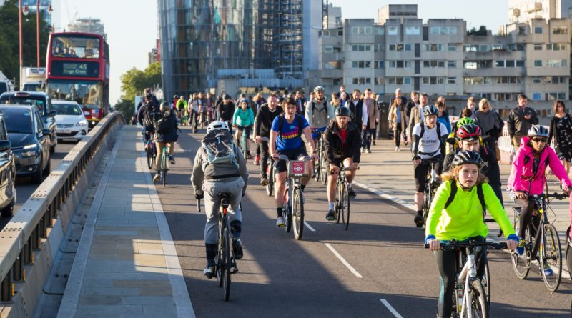
Edinburgh is not alone
Motivations: Air pollution, climate, health
Reducing car kilometres by 30%
Net Zero by 2030
Cities around the world are tackling these with active travel
Paris: 606,000 cycle trips/day
London 1,260,000/day
Berlin 2,223,450/day

Slide 10
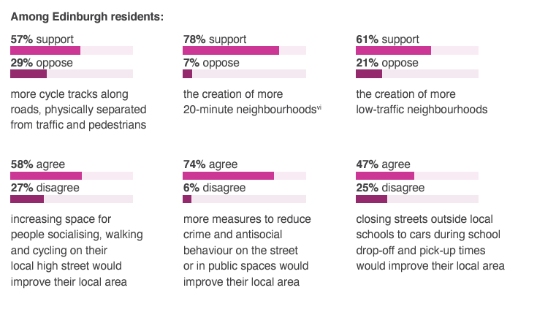
Reasons to be hopeful
Consensus-building – people support this?
A decade of legwork is done?
There is motivation (climate, etc.)
Edinburgh isn’t doing this alone
Political will …
Overarching plans, not street-by-street battles
What’s been achieved so far is good…if that process can be accelerated…

Slide 11
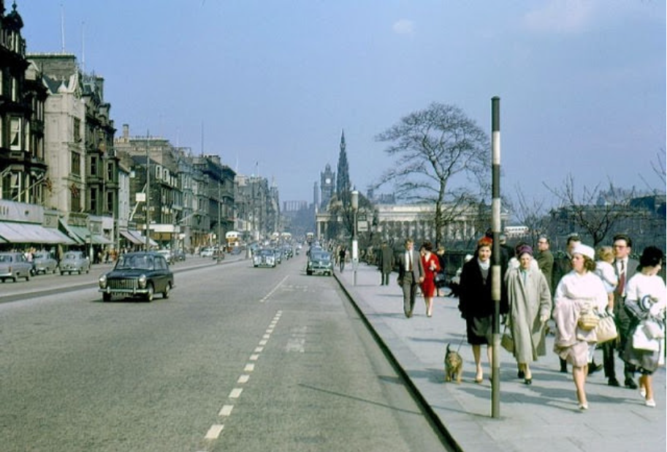
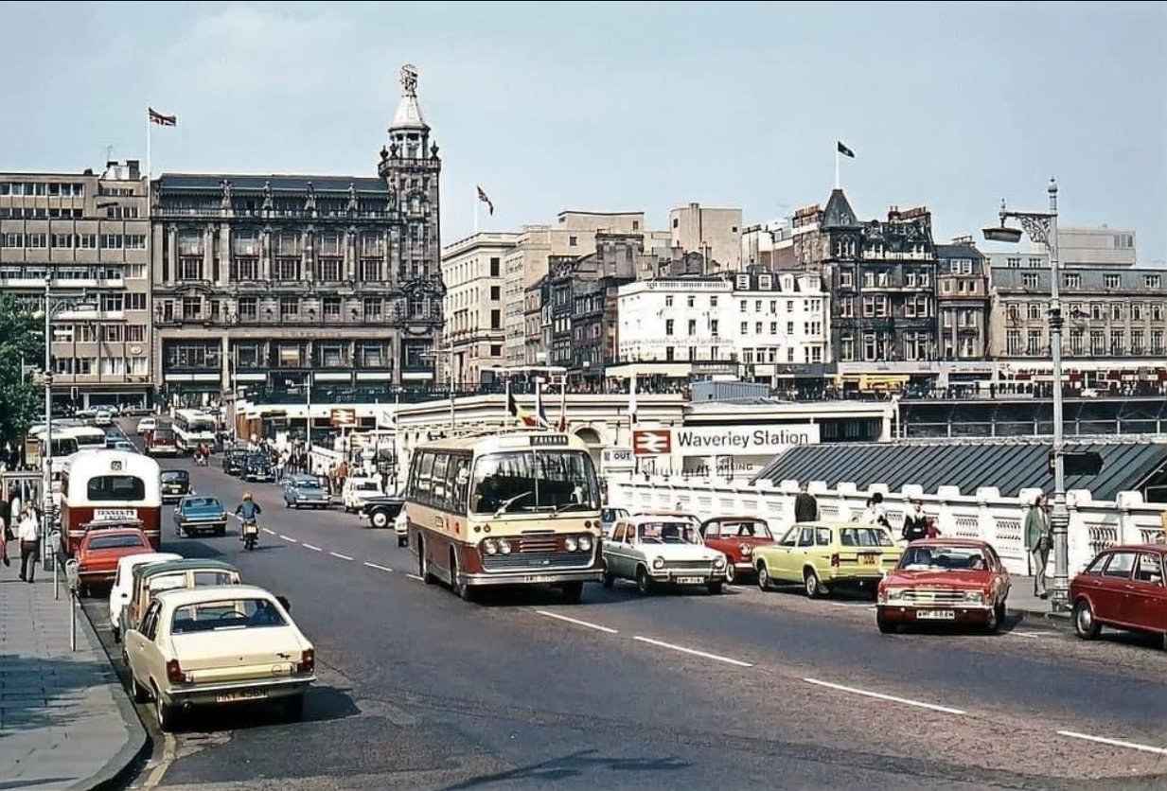
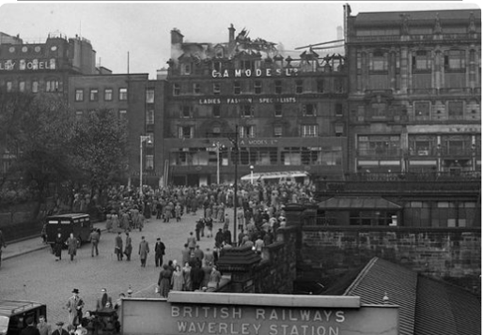

Slide 12
Thank you!

Slide 13
Ghent vs Edinburgh
 | Ghent | Edinburgh
Size (square miles) | 96 | 102
Residents | 262,000 | 559,000
Cycling mode share (pre-measures) | 22%

