Slide 1
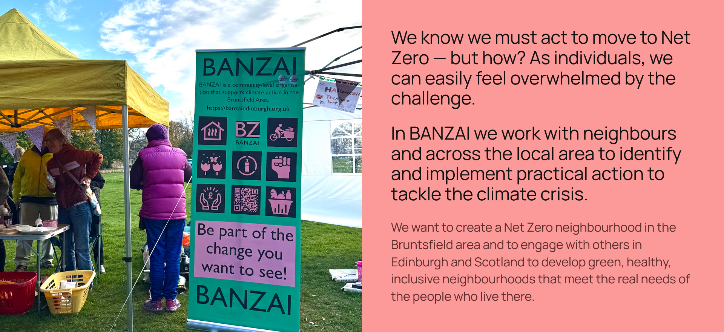
Notes:
Intro to BANZAI

Slide 2
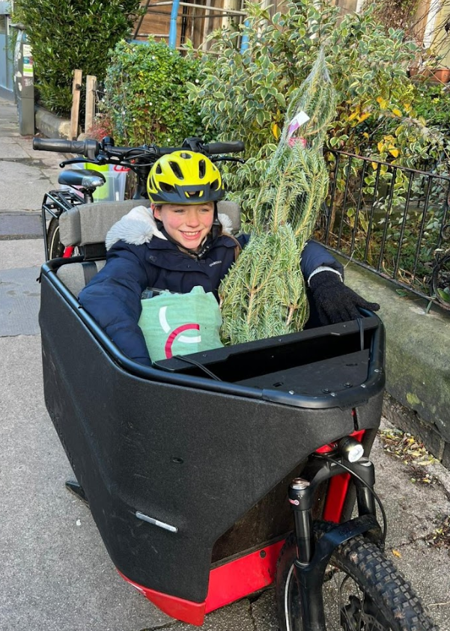
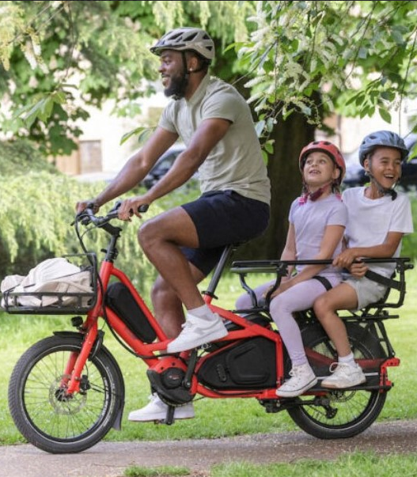
BANZAI Cargo Bike Library
Launched November 2024
Free to use
(no commercial use)
74 fully signed up members
Over 100 loans
Food rescue scheme
100% positive feedback
96% have a more positive view of Cargo Bikes after borrowing
Most have borrowed multiple times despite never having used a Cargo Bike before
Notes:
Future? Now A4A funded for more of same. Separate Librarian and project development roles. Increase reach. Higher SIMD areas. Would be good to grow. Collaborate with others (eg PCE, SW20, N Ed Arts?) on maintenance? Combine with other sharing economy ideas: tool library, book library(!), library of things …

