Slide 1

Active Travel
Developments

Slide 2
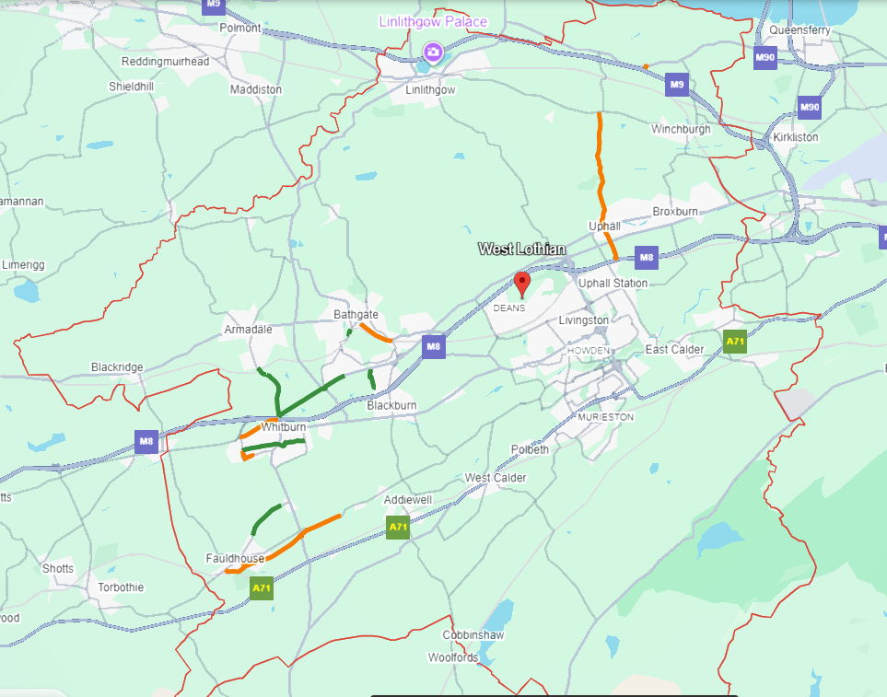
Overview
13.
14.
15.
6.
8.
11.
3.
16.
1.
5.
7.
12.
2.
4.
10.
9.

Slide 3
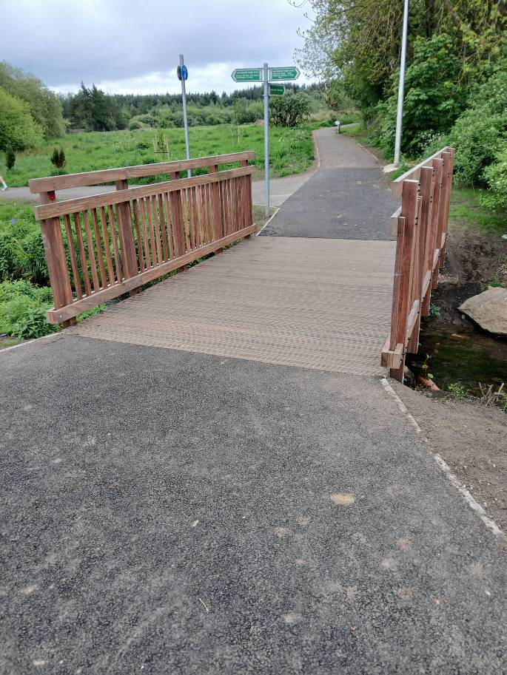
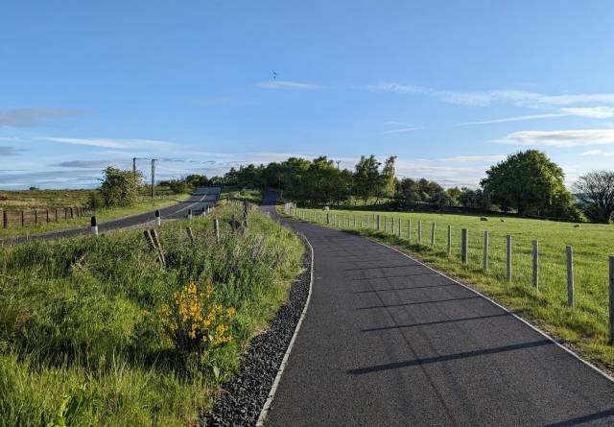
Recently Completed
1. B8084 – Whitburn to Armadale (2021)
2. Whitburn Town Walk – Phases 1-3 (2024)
3. A706 – Boghead to Whitdale R’bout (2022)
4. Fauldhouse to Longridge (2018)
5. Wester Inch to Whitehill Industrial Estate (2023)
6. Whitburn Road, Bathgate (2021)
Whitburn Town Walk
B8084 – Whitburn to Armadale

Slide 4
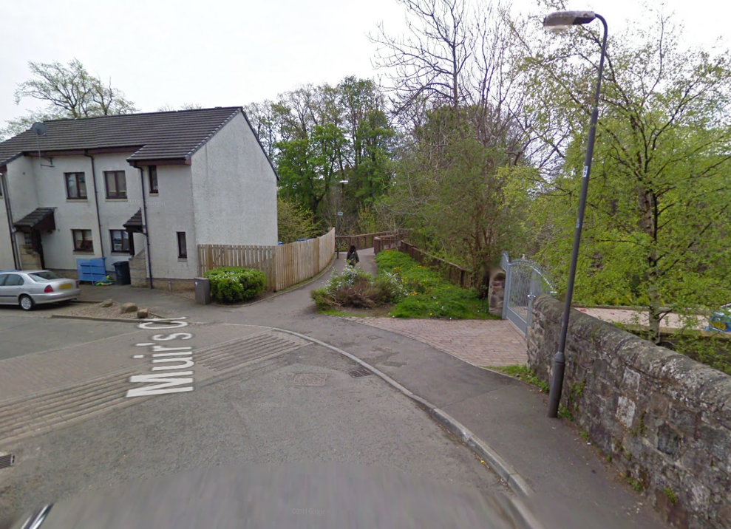
Under Development
7. B7066 – Heartlands to Whitburn – 2025
8. Edinburgh Road, Bathgate –2026
9. Fauldhouse to A706 – 2025
10. A706 to Bents – 2027
11. NCN75 to Blackridge Station – 2027
12. Dixon Terrace, Whitburn – 2026
13. Duntarvie Junction Crossing – 2026
14. Threemiletown to Uphall – TBC awaiting funds
15. Uphall to Uphall Station – TBC awaiting funds
16. Calderwood NCN 75 new section through Cala and Persimmon sites
Uphall to Uphall Station to be developed

Slide 5
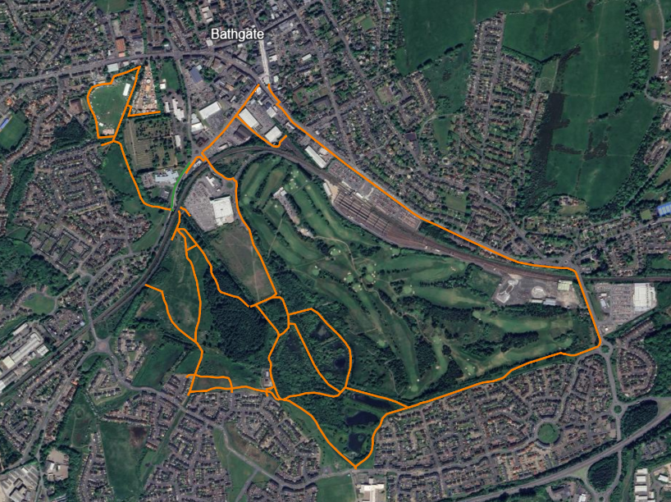
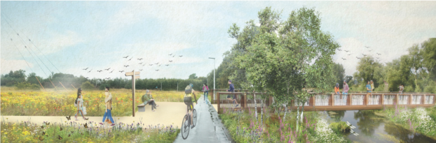
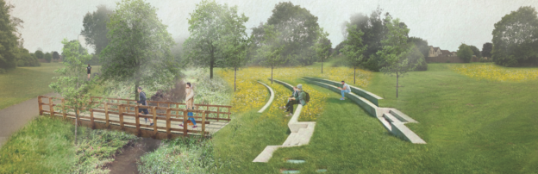
Bathgate Meadows Nature Park
20 individual routes
50 individual strings
Approx. 9km total length
Different treatments location dependent

